Slide 1
Transitioning Into Practice
FMC - June 6th 2015, Moncton
Darren Martin, MD, CCFP, chair FFYFP at NBCFP

Slide 2
COI Declaration
I have no potential bias to declare for this presentation
Mitigating bias - N/A
Discloser : Some of the information in this presentation has been collected by many discussions with more experienced family physicians and may not be based on “official” studies or reports.

Slide 3
Learning Objectives
Types of practice
Step by Step approach to start working
The business side of medicine
Building your team
Setting up your office
Organizing billing and finances

Slide 4
Types of Practice
 | Advantages | Disadvantages
Solo
Group
Locums
Transition / Take over
New number

Slide 5
Types of Practice
 | Advantages | Disadvantages
Solo | Complete autonomy, full control, fewer distractions, dedicated staff | Increase cost, more responsibilities, coverage issues, no peer support
Group | Sharing cost / economy of scale, task sharing, 2nd opinion is close | Divergence of opinions, space issues, need for legal agreements
Locums | Easier transition, less paperwork, identify pros/cons of offices, deals on overhead | No routine, not sure to have work, medicare issues, need legal agreements*, rules of the other MD
Transition / Take over | Office already set up, available charts, mentor for the first months | Hard to change rules/habits, you are in someone else's shoes, quick transition
New number | Your rules/your ways, transition at your pace | A lot of work to set up everything, slow income increase, may be hard to find

Slide 6
Now, where to start ?

Slide 7
Hospital Privileges
The hospital(s) where you will work will grant you the privileges (and practice number)
To know job opportunities get in touch with :
Nicole Newman (nicole.newman@gnb.ca) - Health Human Resource Advisor GNB
Evelyne Valotaire (evelyne.valotaire@vitaliteNB.ca) - Vitalité
Darlene Doiron (darlene.doiron@horizonNB.ca) - TMH
Carol Clark (carolm.clark@horizonNB.ca) - Saint John
Denise Coulombe (RecruitMD3@horizonNB.ca) - Fredericton and Upper River Valley
Debbie Donovan (debbie.donovan@horizonNB.ca) - Miramichi

Slide 8
Congrats, you have a job !

Slide 9
Hospital Privileges
Each hospital will want forms to be filled - you can start the process even if you do not have every results/confirmations…
These forms will very likely include :
Medicine Diploma
Resume
Licence College of Physicians and Surgeons of NB
CMPA proof of insurance
CFPC exam results
LMCC II exam results
Signed confidentiality agreement

Slide 10
CMPA
Call them to inform that you are no longer a resident, but an active working MD. Ask for a proof of insurance to be send to you. (1-800-267-6522)

Slide 11
College of Physicians and Surgeons of NB
Call 1-800-667-4641, ask for licensing forms
They will also want :
Resume
Three reference letters (as per form)
Two pieces of ID with picture
LMCC certificate*
CCFP certificate*
$150 cheque
Certificate of standing if residency outside of NB (may take 4-6 weeks)

Slide 12
College of Physicians and Surgeons of NB
* If you are starting to work early in July (or you had a bad day and did not pass the CFPC exam), these certificates may not be ready in time. A letter from your program director stating that you are ready to work will be sufficient initially.

Slide 13
LMCC
Statement of results available at :
https://portal.physiciansapply.ca/Account/InitialLogin

Slide 14
CFPC
You will receive a certification letter via mail about one week after results are available
www.cfpc.ca —> login —> Exams

Slide 15
Medicare
Go to : http://www2.gnb.ca/content/gnb/en/departments/health/healthprofessionals.html
There, you will find links to :
Medicare practitioner registration
Direct deposit
Teletransmission application and agreement
Practitioner’s authorization (for people that will be doing your billing)

Slide 16
Medicare
Call 506-444-5376 for questions
To be mailed at : P.O. Box 5100 Fredericton, N.B. E3B 5G8
To see your payments and reconciliation :
Health portal/physicians communication system
http://hps.gnb.ca/default-e.asp
Call 506-453-8274 to activate

Slide 17
WorkSafe
Different billing number… Call 1-877-647-0777 to activate an account.
You will need you CPSNB number

Slide 18
NBMS
They will contact you once your CPSNB has been approved.
Their fees will include the CMA registrations and your access to many services, including MD financial management and OMA insurance.
Fees also includes CME reimbursements :
$3 893 - Moncton, Fredericton, Saint-John
$5 559 - others
http://www.nbms.nb.ca/

Slide 19
Meditech (ROAM), Impax
Different for every hospital, usually set up on your orientation day

Slide 20
Associations Summary
Associations | Abreviation | Web sites | Fees per year | Payable for :
The College of Family Physicians of Canada | CFPC | www.cfpc.ca/ | $741 + $152 (NBCFP) | Month of your birthday
The NB College of Family Physicians | NBCFP | www.nbcfp.ca/ | Included | -
College of Physicians and Surgeons of NB | CPSNB | www.cpsnb.org/ | $580 + $80 (if Inc.) | January 1st
NB Medical Society | NBMS | www.nbms.nb.ca/ | $2220 + $100 (GP section) | January 1st
Canadian Medical Association | CMA | www.cma.ca/ | Included | -
The Canadian Medical Protective Association | CMPA | www.cmpa-acpm.ca/ | $3156 | Monthly or Yearly (Jan 1st)
Active hospital staff | N/A | N/A | ~$200 | Variable

Slide 21
Let’s talk business

Slide 22
Building Your
Advisory Team
Financial Advisor - Quarterback of your team
Debt management, insurance planning, incorporation planning, investment strategy
Accountant/Tax consultant
Advice for tax deductions and credit strategies
Insurance Advisor
DISABILITY insurance, LIFE insurance, overhead insurance, critical illness insurance, HEALTH and dental insurance
Lawyer
Professional contracts, incorporations (wills, POA, home purchase)
Banking Partner
Look for low monthly fees and low interest rates

Slide 23
Building Your
Professional Team
Medical Office Administrator - Quarterback of your team and face of your practice
Look for : sense of initiative, professional, people skills (bilingual ?), you can trust 100%
Nurse
Helps with medical task such as vaccinations, vitals, INRs, initial intakes, forms to be filled and patient education. May be a source of income
Clinic Manager
Saves a lot of time and energy if you practice in a large group
Medical Assistant
Cheaper then a nurse but needs more supervision
Colleagues and Mentors
People you can rely on to help with medical or business questions

Slide 24
Negotiation
Like a business owner, you now have to negotiate !
Don’t forget :
Be prepared (Your goals, available options, plan A and B, what you are willing to bargain/let go)
Be fair
Control you emotions and reactions
Be polite
Be confident
Think of long term

Slide 25
Contracts
A contract should be reviewed by a lawyer and include :
Start date
Hours of work
Salary
Sick leave/personal days provisions
Overtime policy
Holidays policy
Probation period
Termination clause
Attach : job description and office politics
**All your employees should have a signed contract before you make the other candidates aware you did not choose them.

Slide 26
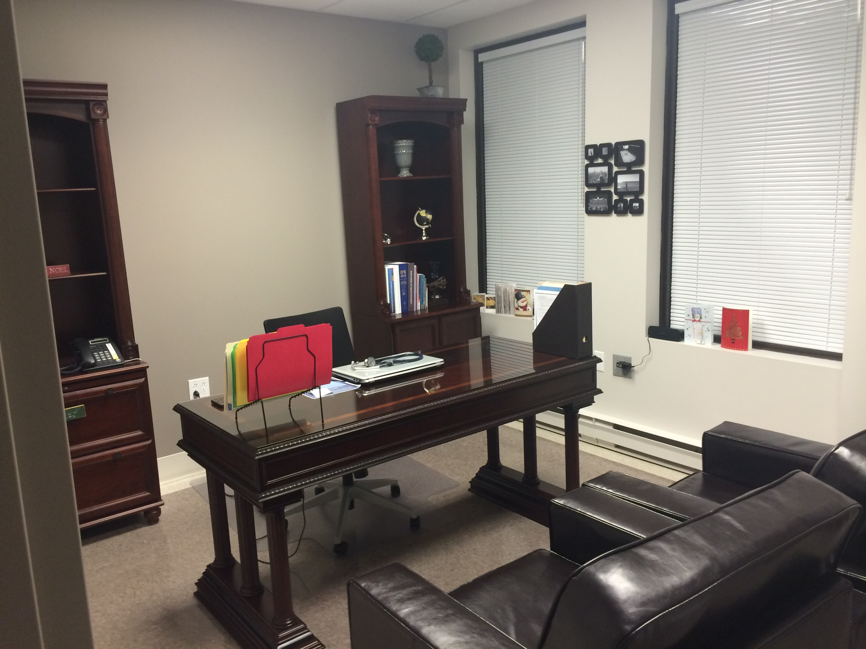
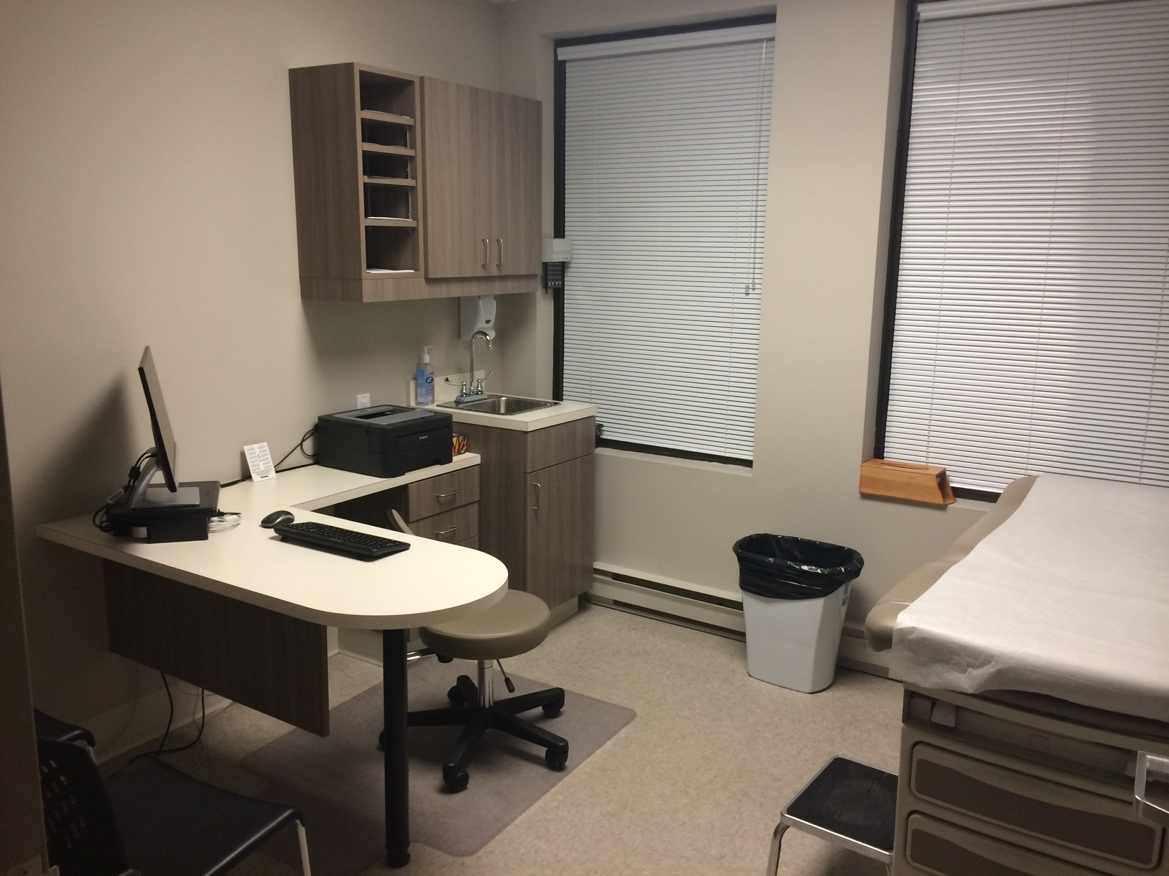
Setting Up Your Office

Slide 27
Space and Cost
Exam room = 100-120 square feet
Clinic space : Exam room space
~4-5:1 if solo practice
~3.5-4:1 if two or more
Rent : ~$10-25 + tax/square feet/year
Electricity : ~$2-3/square feet/year
Maintenance : ~$2/square feet/year

Slide 28
Staff and Salaries
Staff : ~1.2 FTE employee / MD
MOA : ~$15-20+/h depending on experience
Nurse : ~$35/h
Managing role : ~$18-20/h
Assistant: ~$12-14/h
*Keep in mind, there is ~11% extra cost that will be paid by employer to the receiver general

Slide 29
Other Costs
Office set up (~$45 000-50 000 for a 2 exam room office)
Medical supplies ($1 500- 2 000 / year)
Office and other supplies ($1 200 - 1 700 / year)
Phones, fax, internet (~$1 500 - 1 800 / year)
Parking fees (~$250 / year)
EMR ($200-500 / month +/- initial cost, up to $20 000)
Property Insurance (~$500 / year)
Disability Insurance ($1 200 - 2000 / year)
Medical protection insurance (~$3150 / year)
Association fees (~$4 000 / year)
Other employees - janitor, accountant,billing, scanning…

Slide 30
Overhead Summary
You can expect ~$70 000-80 000 / year (and even up to $100 000 in some cases)
with an extra ~$50 000 for year one

Slide 31
Medical and Office Material
See attached appendix

Slide 32
Clinic Pamphlet
For your patients, to explain your clinic rules
May include :
Brief introduction
Address
Phone number
Hours of operation
Clinic particularities (after hours, medical education, hospitalization rounds etc.)
Appointment expectations
No show policy
Services not covered by Medicare
Steps for prescription renewal or test results
Confidentiality and respect policies

Slide 33
Organizing Your Billing
NB Physician’s Manual
http://www.gnb.ca/0394/pdf/2014/physician_manual-e.pdf

Slide 34
Billing - Top 18 Useful Codes
Service | Code | Units @$1.52 | $
Office visit | 1 | 29 | 44.08
Walk in clinic | 3 | 28(at $1.05/unit) | 29.50
Diabetic patient | 8109 (yearly) | 83 (at $1.01/unit) | 83.83
COPD patient | 8113 (yearly) | 60 (at $1.01/unit) | 60.60
Pap material (+ visit) | 1999 | 8 | 12.16
70 and older | 8101 | 36 | 54.72
Infiltration (+ visit) | 1948 | 15 | 22.80
Injection (no visit) | 2 | 13 | 19.76
INR | 1898 (Monthly) | 11 | 16.72
Immunisation | list | 8 (+visit) - 13 (no visit) | 12.16 - 19.76
Psychotherapy | 20 | 24 q 15 min | 36.48
Hospital admission | 2173 | 40 | 60.80
Visit hospital | 2174 | 26 | 39.52
Discharge hospital | 2175 | 32 | 48.64
Medically discharged | 8117 | 12 | 18.24
Urgent visit @ hospital | 2856(night) - 2855(day) | 70 - 21 | 106.40 - 31.92
On call stipend | 8989 | 139 (at $1.05/unit) | 145.95
Extra Mural Communication | 210 | 15 | 22.80

Slide 35
Organizing Your Billing
Direct billing fees - as suggested by NBMS
Examination for third party : $75-125
Disability forms : $50-75
Insurance company assessment : $150 + $1 per photocopy
Drug coverage and Special Authorization : $10-35
Complete disability report : $125 (Canada Gov pays a max. of $85)
Proof of immunization : $10-20
Medical-Legal report : $250-500
Court appearance : $250-500 per hour (minimum of 3h, including preparation time)
Copy of chart for lawyer : $50 + $1 per page
Prescription renewal : $10-30
Missed appointment : 30-100% of Medicare fee
Pages copied for patient : $0.25/page
Chart transfer : $35-50 + $1 per page

Slide 36
Finances
Organization is key !!!
You need to keep track !
Corporate / Personal accounts
Team members to help you with this :
MOA
Medicare, Work Safe, Direct billing invoices, Bills
Billing
“Specialist” vs MOA vs Partner vs You ?
Accountant / Tax consultant
Income taxes (Personal and Corporate), ways to legally advantage yourself
Financial planner
Answer questions, individualized plan, ways to legally advantage yourself, long term planification. Bank vs Private vs MD management

Slide 37
Darren’s Tips and Tricks
Don’t forget : Not everyone has your best interest in mind, contracts are important
You want to be paid for what you do, experience is an important asset for your billing
When we graduate, we are ready to practice medicine, however we are not formed to open a business - surround yourself with a good team / mentors
Good corporate expense = regular meetings with colleagues
You need to balance work and personal life - High stress/Burnout rate is 40-50% among first line physicians. Only 48.4% of NB’s family physicians are satisfied of their personal life/work balance.
http://www.cfpc.ca/FF_Work_Life_Personal_Life_Balance/

Slide 38
Special Thanks
Dr Jules Melanson
Dr Julie-Eve Arseneault
My many mentors that helped me get started

Slide 39
Links / Emails
Darren Martin - dr.darren.martin@horizonNB.ca
NBCFP - http://www.nbcfp.ca/
Ressources —> First Five Years
CMA transition to practice tools - https://www.cma.ca/En/Pages/transitioning-to-practice.aspx
CMA Practice management modules : https://www.cma.ca/En/Pages/pmc-modules.aspx
Resident’s timeline - https://www.cma.ca/En/Pages/resident-timeline-tool.aspx
NBMS physician help program : - 1-888-453-7272 or SanteHealth@nbms.nb.ca

Slide 40
Questions ?

