Slide 1
Do You Know What You Don't Know?
The Workshop
Julie Langlois, MD
NBCFP FMC 2015
CPD for Physicians...

Slide 2
Disclosure of Potential Conflicts of Interests
None

Slide 3
Disclosure of Commercial Support
None

Slide 4
Management of Potential Bias
Not applicable

Slide 5
Learning Objectives
During this workshop, the participant will learn:
• How Continuous Professional Development is evolving
• What are the data on physician education and the risk factors for a decline in competence
• How to do a learning plan and meet our learning needs as physicians
• Understand how CPD can have an impact on our patients if we are willing to apply our learnings to our practice

Slide 6
Trends in CPD

Slide 7
Events
Workplace-based learning

Slide 8
Physician's Satisfaction (or update model)
Practice/Patients Outcomes (or performance model)
Notes:
Physicians often choose topics that they like or know well already instead of areas of difficulties and gaps in practice

Slide 9
Individual
Team/Practice Focus
Notes:
More and more pluridisciplinary meetings/conferences also mixing family physicians with other specialties

Slide 10
Tertiary/University Center Expert
Local Expert, Colleague or team member

Slide 11
Medical Expert
Broad Conception of Competency and Practice
Notes:
Changes in vocabulary
-Planning committee instead of scientific committee
-Continuous professionnal development instead of continuous medical education
-CPD will address not only clinical work but also teaching, research, administrative tasks that are part of our compentency

Slide 12
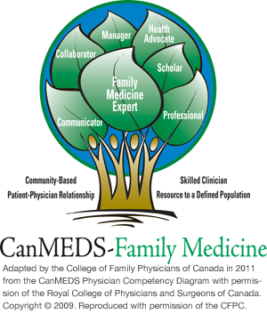
Can-MEDS FM Roles
Notes:
Today's presentation is the best example
You won't be a better clinician after those 3 hours but better manager and scholar maybe +/- professionnal)
-autres rôles que medical expert sont moins sexy, moins populaires et attirants car ils demandent changement de comportement au lieu changement connaissances et ce sont svt des unperceived need (ex les plaintes/erreurs/poursuites des patients sont svt des prob de communication et non d'expertise) "Emotionnal" Intelligence (ie toutes les autres facettes d'un individu) est concept connu ++ en business pour faire un bon professionnel mais peu en médecine

Slide 13
Industry/Pharma (Marketing)
Organization/Faculty
(Education)
Notes:
At this time, 80% of accredited programs come from pharmaceutical companies
Eventually, everything will be put in a founding pool

Slide 14
Being a spectator
Being engaged and responsible for our education
Notes:
Development of a learning plan at the beginning of 5-year cycle (mandatory for certificate of added competence)

Slide 15
Different Ways of Learning

Slide 16
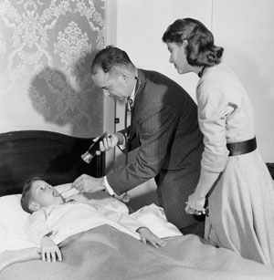
The Traditionnal (or old-fashion) Ways
Live Conferences
Journal reading
Medical Rounds
Notes:
-Good evidence that plenaries often given by other specialists are less likely to change practice
- Ironically, this is the activity that is perceived to have the most significant impact for members according to National Survey
-Be very careful with practice guidelines as many of them are based on expert opinions and some are biased (lot of COI among developpers) and few are peer-reviewed and even fewer involved participation of family physicians.
-Problems is that you become saturated after a while

Slide 17
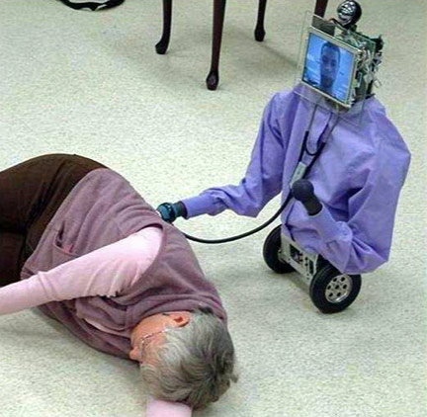
The Techno (or Geek) Ways
Web-based programs (Ex. mdBriefCase®, Self-learning®)
Push-Technology (InfoPoems®, MiniPearls, etc)
Pull-Technology programs (UpToDate®, Dynamed®, etc)
Webinars
Notes:
Attention dépendance à techno et effet qu'on consulte moins nos pairs (ou résidents consultent moins patrons)

Slide 18
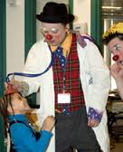
The "Did you ever hear about those?" Ways
Pearls
Linking Learning to Practice
Linking Learning to Teaching
Examiner
Linking Learning to administration (Committee participation)
Linking Learning to Research
Notes:
Committees have to be related to patient care, practice standards or quality of care Max 50/cycle or educational planning committee

Slide 19
The Very Effective (or Super) Ways
Structured, regular and interractive small group activities
Simulation
Workshops and practice of skills
Clinical/practice audit and feedback or self-assessment programs
Notes:
-Regular interractive small group activities based on precised learning needs is the most effective learning activity *Bémol: il faut demander à nos collègues leur source d'info/interroger leur niveau de preuve
-Groupe aide aussi a/n compassion, sympathie, soutien psychologique
-AAFP self-assessment program et réciprocité

Slide 20
The quality and quantity of CPD have a positive influence on the quality of medical practice.
Ref. Influence de la formation médicale continue sur la performance clinique, Can Fam Physician 2013;59:518-525
Notes:
Selon cette même études, les médecins faisant partie du CMFC performaient mieux car ils avaient des exigences plus rigoureuses en matière de maintient des compétences (250 crédits par 5 ans dont 50% certifiés)

Slide 21
Determinants of Impact on Practice
Learning activity stimulated by a question and the management of a specific patient or a group of patients
Reflexion activity and impact assessment
Case-discussion and utilization of tools to facilitate integration of changes to practice (like algorythm or info to patients)
Motivation of the learner
Notes:
-Activities are either ineffective in changing our practice. At the most 10-40% chance of changing practice (le counselling et la prise ne charge des patients est ce qui est le plus dur à changer alors que les habitudes de prescription et d'investigation sont les plus faciles)
-Reflexion: Ideally after the activity and several months after
-Reflexion on potential changes, obstacles to change, etc
Important to discuss obstacles in small groups and find solutions

Slide 22
Clinical Case

Slide 23
Determining factors in the quality of practice
Age of physician
Degree of professionnal isolation (office practice only vs practice in health care institution)
CPD
Notes:
Based on studies done with professionnal inspection visit program (which monitor quality and quantity of CPD activities (credited vs non-credited), record keeping, quality of the clinical investigation plans, of diagnosis and of treatment plans) with revision by peers.

Slide 24
How do we stay "up-to-date" in NB?
# hours of CPD per week
- NB Family physicians 2,39
- Canadian Family physicians 3,34
- NB Other specialists 3,23
- FP Female (Canada) 3,06 vs Male 3,56
- < 35 y.o. physicians spend less hours doing CPD than older physicians
National Physician Survey 2013
Notes:
*Look at the 2013 data and my notes from NCCPD section
Same working hours

Slide 25
Barriers to CPD
Abondance of information and unfamiliarity with levels of evidence
Difficulty tranferring information into practice
Choice of ineffective learning activities
Difficulty integrating CPD in a busy practice
Challenge in autoevaluating learning needs
Notes:
More than 400 000 publications per year
Review database (Cochrane)
Most individuals overestimate their performance and competency, especially those who have less than average performance

Slide 26
Personal Learning Plan in 5 Steps
1. Make my practice profile
- list of all my professionnal activities
- caracteristics of my patient's cohort

Slide 27
2. Autoevaluation of
My learning needs
I have new information and I realize I need to know more (emergent needs) | I know what I don't know so what I want and need to know (perceived needs)
I think I know something that I don't know (malcalculated or misperceived needs) | I don't know what I don't know (unperceived learning needs)
Notes:
Retroaction by peers and occasions of discussions among peers is determinant in autoevaluation of learning needs
In other words, you need others (other health prof, other specialists, colleagues in fam med and our patients! (Particularly regarding communication)) or an audit or other form of assessement

Slide 28
3. Select and prioritize topics to cover and skills to achieve
Without neglecting "non medical expert" competencies like communicator, collaborator, administrator and so on.

Slide 29
4. Identify potential activities that would allow me to meet my learning objectives
Include variety (solo, group and assessment) and respect your time's constraints
Look for certification as an indicator of quality and integrity

Slide 30
5. At the end of my cycle, evaluate if I met my objectives
Did I meet obstacles?
Do not forget to ask for credits for this reflexion on my practice and the learning linked to it

Slide 31
Commitment to change...
Notes:
Physicians who formulate an explicit comitment to change have more chances of making changes in their practice than physicians who do not

Slide 32
References
McMaster Practice Based Learning Program March 2012 Module "Apprentissage basé sur la pratique et fondé sur des données probantes"
"Influence de la formation médicale sur la performance clinique", Canadian Family Physician vol 59 mai 2013
"A Guide to Mainpro Accreditation", CFPC Website

Slide 33
Supplements

Slide 34
Development of a certified program

Slide 35
Who Can Give Certification of Educational Activities?
Colleges (Royal College of Physicians and Surgeons, College of Family Physicians, American Academy of Family Physicians, etc)
Faculties/Universities
Notes:
Reciprocity programs
Ex.Symposium CA poumons et NBHPCA

Slide 36
Key Elements of Certification
Planning Committee involving physician
Learning needs assessment
Program development with precise learning objectives and relevant to family practice and respecting its principles
Program review by a trained physician and ethical review
Evaluation form and feedback

Slide 37
Activities of the CCFP
FMF
Canadian Family Physician
Pearls, Linking Learning to Practice
Self-learning
CPD grants
CFPC CPD Award

Slide 38
Activities of the NBCFP
Family Medicine Conference
Provincial Tour: presentation on CPD available on the website
CPD grant

Slide 39
Appendix 1 Linking Learning to
practice submission
http://surveys.cfpc.ca/s/linking-learning-to-practice

Slide 40
Appendix 2 Pearl submission
http://surveys.cfpc.ca/s/pearls-submission

Slide 41
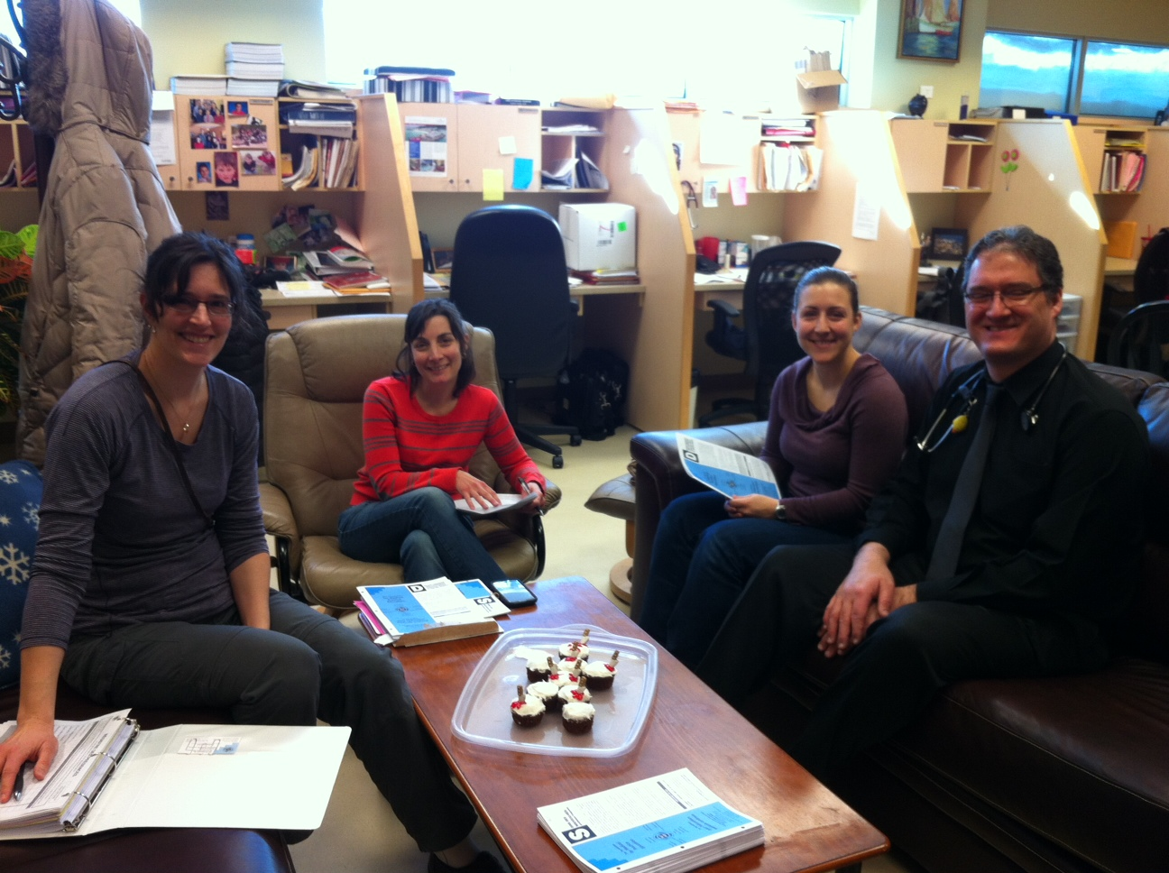
Appendix 3 Example of Small group practice based learning program
http://fmpe.org

Slide 42
Appendix 4 Non-Member
Mainpro Participation
http://www.cfpc.ca/Nonmembers/

