Slide 1
Dyspnea in end of life
Cynthia Savoy MD CCFP
CHUDumont, Moncton, NB

Slide 2
Clinical Case
You’re called to Mr. LeBlanc’s bedside (79 yo)
Known for COPD and is a smoker
x past year, Dx of adenocarcinoma of the lung with local and bone metastases.
Bedridden
Poor feeding
He is short of breath, tachypneic, is coughing and spitting
He looks like he is suffocating.
His family is panicking
What do you do?

Slide 3
Presentation Goals
List causes of respiratory distress in end of life
Describe the role of opioids in the management of dyspnea
Describe the use of non pharmacological measures
Determine when the use of a distress protocol would be appropriate

Slide 4
Prevalence
Varies depending on underlying condition
COPD: 95%
Congestive Hear Failure: 61%
ALS: 50%
Dementia: 70%
Stroke: 37%
Cancer: 50-70%

Slide 5
Expressions of dyspnea

Slide 6
How to evaluate dyspnea?

Slide 7
Who is the most dyspneic?
67 yo man with lung cancer?
83 yo woman with COPD and O2 sat. at 90%?
72 yo woman with heart failure and pulmonary oedema?
81 yo man with myelodysplasic syndrome and Hb at 76?
59 yo woman having a panic attack?

Slide 8
How To Measure Dyspnea?
Respiratory Rate?
Oxygen Saturation?
Arterial Blood Gas?
Visual rating scale?
All of the above?
None of the above?

Slide 9
Dypsnea
Like pain, dyspnea is SUBJECTIVE sensation.
The only reliable measure of dyspnea is the patient’s self-report. No tests correlates well with the sensation of being short of breath.
I can’t breath!

Slide 10
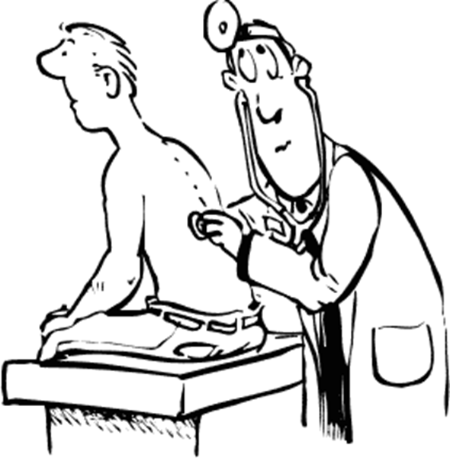
Evaluating the Severity of Dyspnea
Doctors: 28%
Nurses: 35%
Volunteers: 43%
Always rely on the patient!

Slide 11
Pathophysiology
Complex and still not well understood
Central chemoreceptors (acidosis)
Peripheral chemoreceptors (In carotids and aorta are sensitive to hypoxia)
Thermoreceptors in upper respiratory tract
Mechanical receptors in the airways are sensitive to opioids
Muscular mechanical receptors (diaphragm, thoracic muscles)

Slide 12
Evaluating Dyspnea
Always screen for dyspnea
Trajectory (rapid, gradual)
Type (intermittent, continuous)
Severity
Alleviating and exacerbating factors
Concurrent symptoms
Contributing psycho-socio-spiritual factors
Impact

Slide 14
Evaluating Dyspnea
Physical Exam
Investigations depending on appropriateness
Chest X-Ray
O2 saturation
CT scan
Cardiac echo
Bronchoscopy
Spirometry
Arterial Blood Gas

Slide 15
Causes
Airway obstruction
Pleural effusion
COPD
Pneumonia
Lung cancer and metastases
Lymphangitic carcinomatosis
Pulmonary Emboli
Pneumothorax
Aspiration
Cardiac causes (CHF, pericardial effusion)
Systemic causes (anemia)
Neurological causes (ALS, muscle wasting)
Metabolic causes (anemia, acidosis, low Mg, low calcium)
Psychological causes (Anxiety, hyperventilation)
Pulmonary Causes
Extra-thoracic causes

Slide 16
Non Pharmacological Measures

Slide 17
Non Pharmacological Measures
Be a calming presence for patient and family
Fan
Position, upright
Limit the number of people in room
Loosen or remove tight clothing
Lower room temperature
Position by a window
Open curtains
Avoid air irritants
Respiratory exercises
Notes:
Pursed lip breathing

Slide 18
Pharmacological measures

Slide 19
Pharmacological Measures
Oxygen
Opioids
Adjuvant therapies
Bronchodilators and inhaled steroids
Steroids
Phenothiazine
Benzodiazepines
Diuretics
Non-invasive ventilation

Slide 20
Opioids
Decrease sensation of shortness of breath
Act on the respiratory center
Clinical studies have confirmed that opioids are safe and useful at appropriate doses and when judiciously titrated
Effective not only in advanced cancer patients but also in ALS, and terminal cardiac or pulmonary diseases

Slide 21
Opioids in dyspnea
Same model as for pain control
Regular dose with Break-through (BT) dose prn
Start with low dose ex: morphine 2,5-5mg po q 4h and 2,5mg po q 1h prn
Titrate gradually and even slower in non-cancer patients
Do not forget a laxative and anti-emetic
A patient already on opioids can have a 25% increase in their dose.

Slide 22
Conversions
CODÉINE/Tramadol
$$÷10$$
X 10
MORPHINE
$$÷5$$
X2
$÷$2
OXYCODONE
HYDRO-MORPHONE
X 5
$$÷2$$
X2
FENTANYL
Palli-sciences
Notes:
Voici un tableau qui est tout aussi important dans le contrôle de la douleur comme dans le contrôle de la dyspnée!
Il est important de tenter de se tenir à une seule molécule opiacée pour diminuer les risques d’erreurs médicamenteuses.
Il est aussi important de réaliser que la posologie sous cutanée n’est pas équivalent à la dose per os.

Slide 23
Important info on Opioids
PO to SC is 2:1
Hydromorphone 2mg sc= hydromorphone 4mg po
Morphine 20mg po=Morphine 10mg sc
PO to IV is 3:1
If we switch opioids we must first convert and then decrease the dose by 20-50%
Be mindful of dose limits when using combination medication (ex. Tramacet)
Codeine and Tramadol have “limits”
Notes:
Codeine 300-400mg /jour
Tramadol: 400-600mg/jour

Slide 24
Terminal Respiratory Congestion
“Death rattle”
Caused by the accumulation of secretions in patients who are too weak to expectorate
Glycopyrrolate (Robinul): 0,2-0,6 mg sc q 2h prn
Hyoscine hydrobromide (Scopolamine):
0,2-0,6 mg sc q2h prn or patch q72h
*Atropine 1% 1-2 drops SL q2h prn

Slide 25
Acute respiratory distress
Benzodiazepine (Midazolam-Versed)
die or weight $<$70kg-------5mg sc
$>$die or weight $>7$0kg-----10mg sc
Opiacé Si morphine
0-3mg sc q4h------------5mg sc
$≥4$mg sc q4h-------1,5x la dose sc q4h Rx2 (max 50mg)
Si hydromorphone q15min
0-1mg sc q4h------------1mg sc
$>$1mg sc q4h-------1,5x the dose sc q4h
(max 10mg)
Anticolinergique
Robinul or Scopolamine----0,6mg sc

Slide 26
Conclusion
Dyspnea is according to patients description
Dyspnea is linked to many diseases
Opioids are the most useful drugs in the tx of dyspnea
O2 is useful in hypoxic patients
Non pharmacological management is essential

