Slide 1
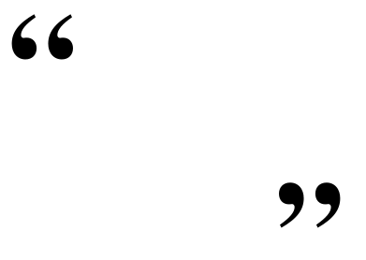

What if there was
one prescription
that could
prevent and treat
dozens of diseases,
such as diabetes, hypertension and obesity?
Would you prescribe it to your patients?
Certainly.
-Robert E. Sallis, M.D., FACSM,
Exercise is Medicine™ Task Force Chairman
Notes:
What an intriguing concept! Surely if there was such a pill or intervention, we would recommend it to patients.

Slide 2
Presenter Disclosure
CFPC CoI Templates: Slide 1
Presenter: Jonathon R. Fowles, PhD, CSEP-CEP, CSCS
  Director, Centre of Lifestyle Studies
  Professor, School of Kinesiology, Acadia University
  Presenting Faculty, Exercise is Medicine Canada
Relationships with commercial interests:
  Grants/Research Support: Thera-band Academy, Steps Count/Diabeters Inc., Remington Medical
  Speakers Bureau/Honoraria: Novo Nordisk A/s, Sanofi-Aventis,
  Consulting Fees: None
  Other: Workshop presenter for the Canadian Diabetes Association, Exercise is Medicine Canada
Notes:
This slide must be visually presented to the audience AND verbalized by the speaker.

Slide 3
Mitigating Potential Bias
CFPC CoI Templates: Slide 2
This presentation will not discuss use of pharmaceutical agents
This presentation may discuss the use of exercise training tools.
Notes:
This slide must be visually presented to the audience AND verbalized by the speaker.

Slide 4


Exercise Is Medicine Canada
Vision
“Physical activity is an integral part of prevention and treatment of chronic disease in the Canadian Health Care System.”
Notes:
CSEP partnered with ACSM to bring EIM to Canada in 2012. Organizations: CCEP, CCFP, CASEM, Canadian Physiotherapy Association, Canadian Society for Psychomotor Learning in Sport and Exercise Psychology , Clinical Exercise Professional Representative

Slide 5
Exercise is Medicine® Canada
Objectives:
Increase the number of health care professionals who are assessing, prescribing and counseling patients in physical activity;
Increase the number of Canadians meeting the Canadian Physical Activity Guidelines and the Canadian Sedentary Behaviour Guidelines; and
Encourage the appropriate use of qualified exercise professionals in the prevention and treatment of chronic disease.

Slide 6
Learning Objectives for today
Understand the scientific basis of the spectacular potential of exercise for the prevention and management of chronic diseases
Integrate the “Exercise Vital Sign” as part of the periodic health examination
Be able to use the exercise referral and prescription tool developed by “Exercise is Medicine Canada” for exercise assessment and basic prescription

Slide 7
Self Reflection – Sharing Activity
Do you know what the Canadian Physical Activity Guidelines recommend?
Do you meet the guideline recommendations?
What are the barriers to meeting the guidelines yourself?
Do you prescribe physical activity or exercise to your patients?
What are the challenges you face in counselling your patients on adopting a physically active lifestyle?

Slide 8
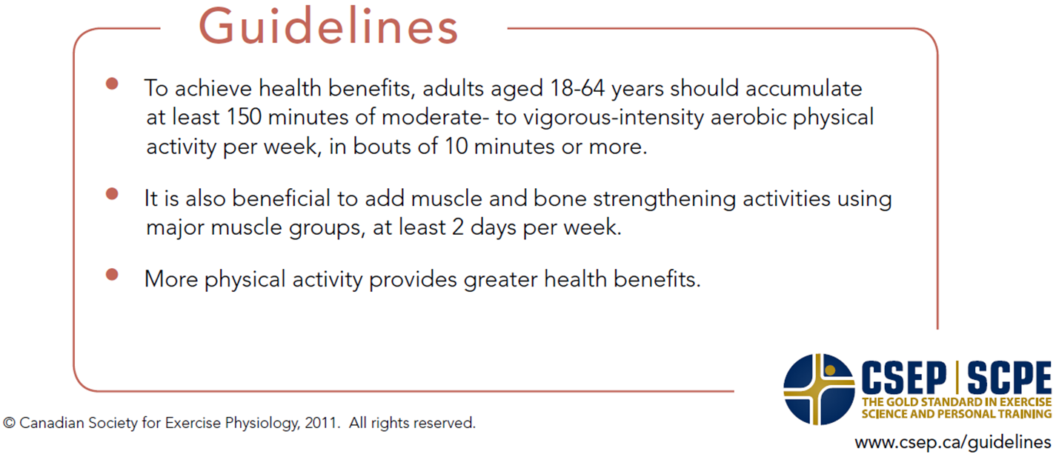
PA Guidelines for Canadians
Similar guidelines aged 65 years and older

Slide 9

Exercise As Medicine
Tremendous health benefits are seen with even low levels of exercise.
Amount of exercise needed to benefit health is much lower than amount needed for fitness.
Regular physical activity at the correct intensity:
Lowers the risk of stroke by 27-45%.
Reduces the incidence of diabetes by 25-58%.
Reduces the risk of cardiovascular disease by 33-50%.
Reduces the incidence of high blood pressure by 33-60%.
Can reduce mortality and the risk of recurrent breast cancer by 25-50%.
Can lower the risk of colon cancer by 30-60%.
Can reduce the risk of developing of Alzheimer’s disease by 40%.
Can decrease depression as effectively as medications or behavioral therapy.
Reduce risk of premature death by 31-50%
Blair et al.,EIM, 2009; Warburton et al., IJBNPA, 2010
Notes:
Suggested Talking Points
Bring the audience’s attention to the specific health benefits of physical activity on some of society’s most common chronic disease conditions.

Slide 10
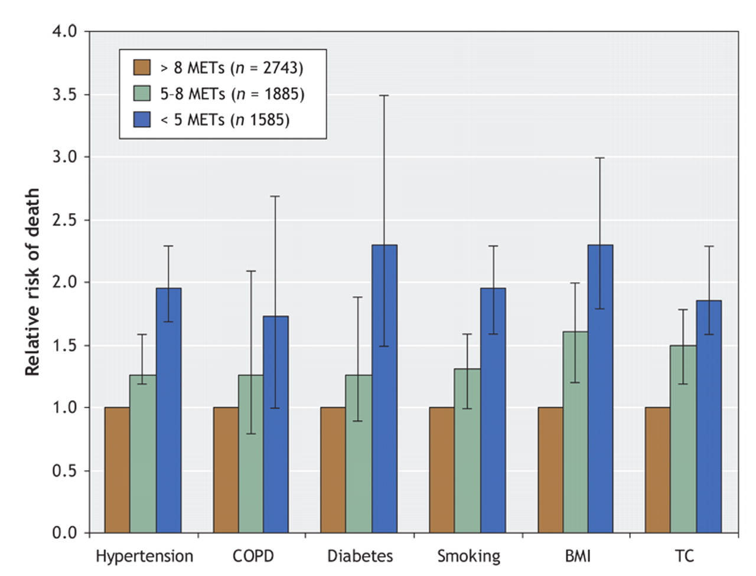

Fig. 1: Relative risks of death from any cause among participants with various risk factors (e.g., history of hypertension, chronic obstructive pulmonary disease [COPD], diabetes, smoking, elevated body mass index [BMI ≥ 30] and high total cholesterol level...
Warburton D E et al. CMAJ 2006;174:801-809
©2006 by Canadian Medical Association
Notes:
Fig. 1: Relative risks of death from any cause among participants with various risk factors (e.g., history of hypertension, chronic obstructive pulmonary disease [COPD], diabetes, smoking, elevated body mass index [BMI ≥ 30] and high total cholesterol level [TC ≥ 5.70 mmol/L) who achieved an exercise capacity of less than 5 METs (metabolic equivalents) or 5–8 METs, as compared with participants whose exercise capacity was more than 8 METs. Error bars represent 95% confidence intervals. Adapted, with permission, from Myers et al38 (N Engl J Med 2002;346:793-801). Copyright © 2002 Massachusetts Medical Society. All rights reserved.

Slide 11
Actual Causes of Death
Leading Causes of Death, US
1. Tobacco, 18.1%
2. Poor diet and
Physical inactivity, 16.6%
3. Alcohol, 3.5%
JAMA March 10, 2004
Deaths per Year in U.S. (1,000s)

Slide 12
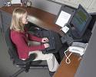
Measured Leisure Time PA in Canada
Canadians (20-79) reporting Mod-Vigorous PA = 52%
Canadians attaining PA criteria:
  > 10,000 steps/day = 35%
  > 150 min MVPA / wk in > 10 min (i.e CSEP & CDA Guidelines) = 15%
  30 min MVPA, 10min bouts, 5 out of 7 days: = 5%
Sedentary: ~10 h/day, light PA ~2h/day, MVPA: 24 min
(Health Reports, CHMS 2007-2009; Colley et al. 2011)
Notes:
Current PA is complete opposite of how our physiology is set up.
When measured by accelerometry only 15% achieve guidelines and less on a daily basis.
We are sedentary most of the day, Pactive for less than 30 min.
Amazing that 30 min still preserves and restore so many health benefits.

Slide 13
Effect of Fitness (CRF) on Mortality
Attributable Fractions (%) for
All-Cause Deaths
40,842 Men & 12,943 Women, ACLS
*cardio respiratory fitness
Blair SN. Physical inactivity: the biggest public health problem of the 21st century. Br J Sports Med 2009; 43:1-2.
Cooper Aerobics Center Longitudinal Study, 1970-2004. In progress
Notes:
Research shows that a low level of cardio respiratory fitness (CRF) exposes a patient to a greater risk of dying than does smoking, obesity, hypertension, or high cholesterol.
Steven Blair Arnold School of Public Health, University of South Carolina, Aerobic Centre Longitudinal Study > 50,000 men and women
Attributable Fractions – estimate of the number of deaths that could have been avoided if that specific risk factor was erased
Low fitness was the strongest predictor of death

Slide 14
Costs of inactivity:
The total health care cost of physical inactivity related to seven primary chronic diseases is $6.8 billion /yr (Janssen, 2012).
The total economic burden of excess weight and physical inactivity in Canada is estimated at $29 billion / yr (Krueger et al., 2014).
The projected cost savings of increasing physical activity rates in Canada, by 1% per year, is $2.1 billion per year, or an accumulated burden reduction of $20.3 billion by the year 2030 (Krueger et. al, 2014).

Slide 15
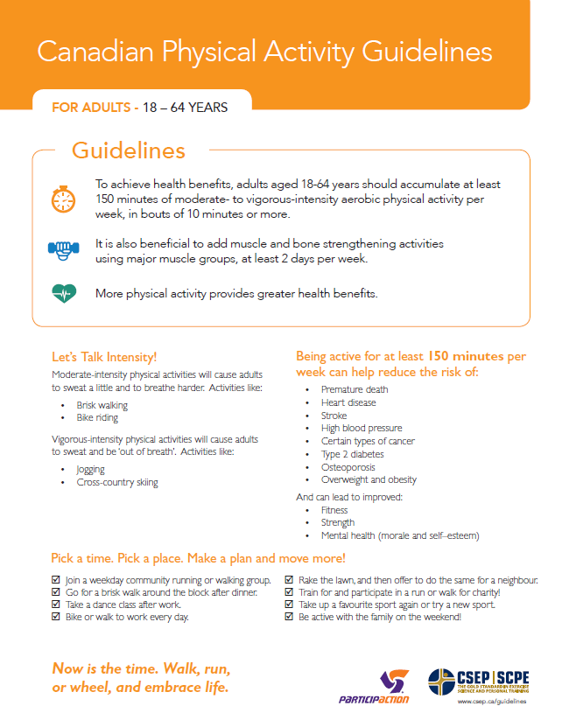
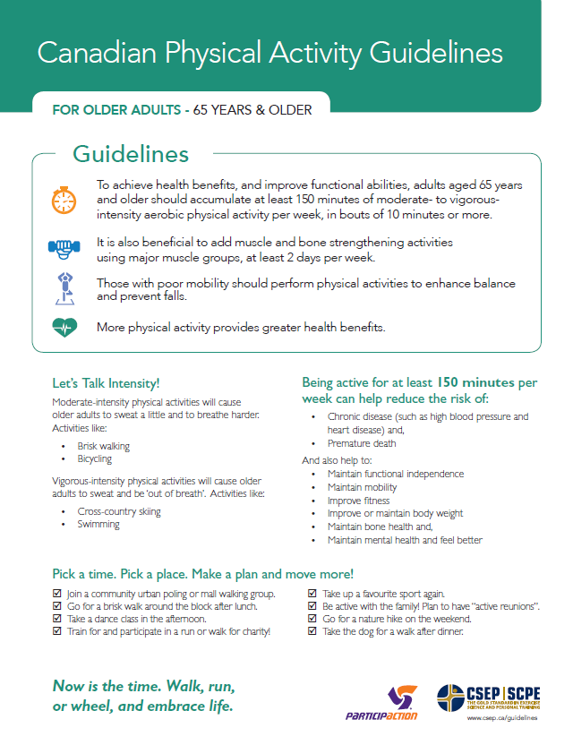
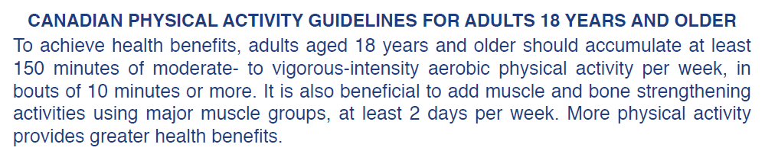
www.csep.ca

Slide 16
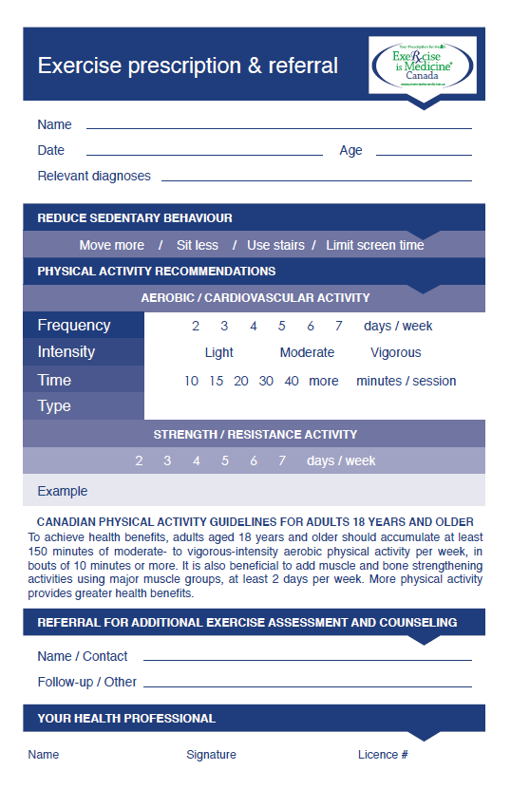
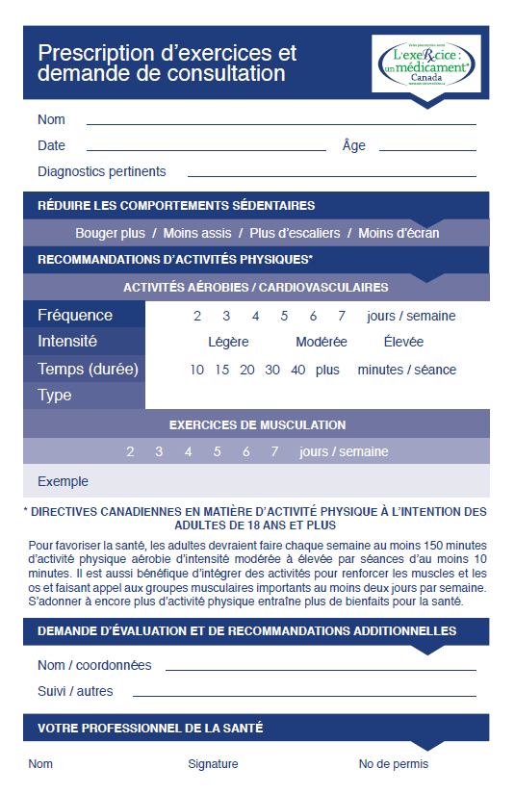

Slide 17
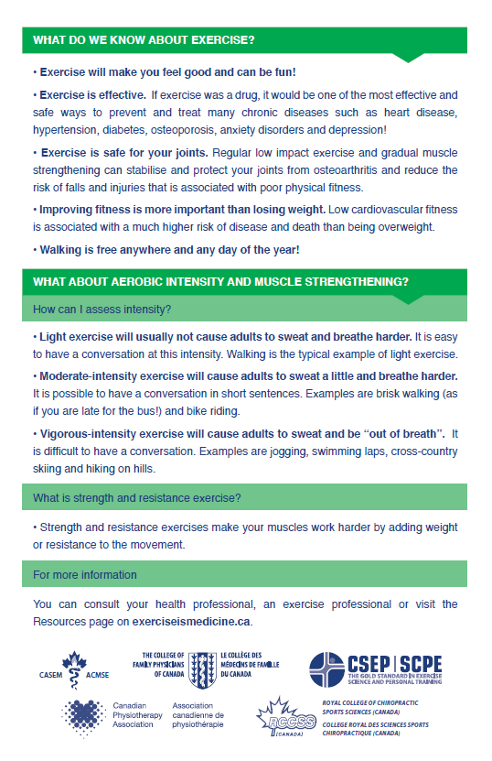
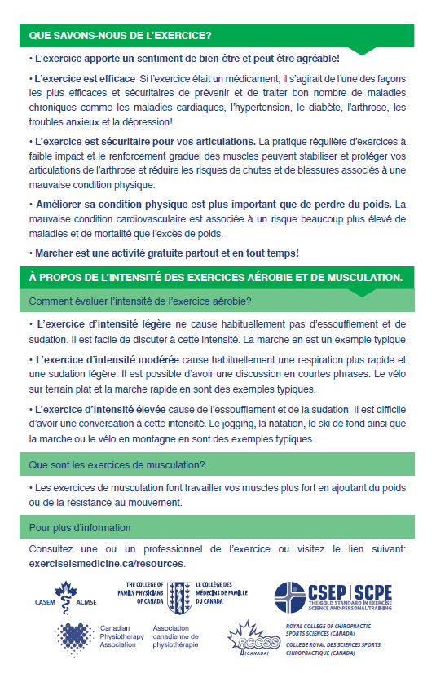

Slide 18

Sponsors of the Exercise Prescription Project

Slide 19
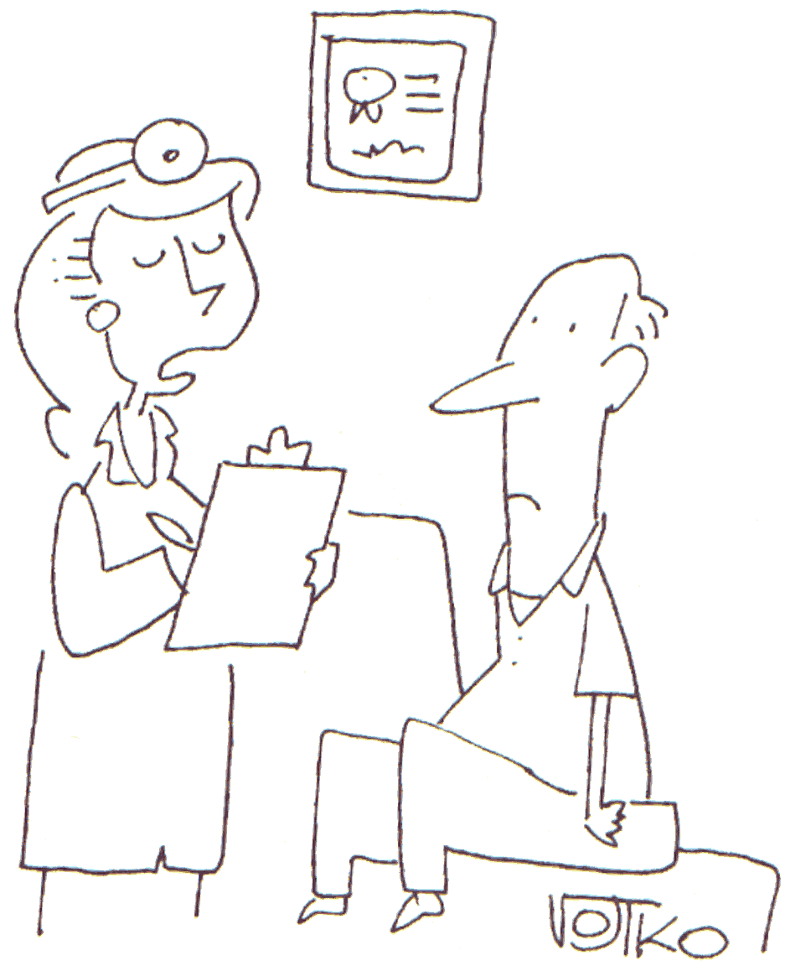
The Five A’s Model for PA Counseling
Ask
ASSESS
ADVISE
AGREE
ASSIST
ARRANGE
Whitlock et al., 2002; Goldstein et al., 2004; Fortier, Tulloch & Hogg in press
Notes:
Starting the behaviour change process.

Slide 20
Counseling Opportunities
Comprehensive
Brief
10-20 minutes
Ask
2-4 min
30 seconds

Slide 21
ASK
EVERY PATIENT
EVERY TIME
Determine patient’s current level of activity
Willingness to exercise
EXERCISE VITAL SIGN
Notes:
Suggested Talking Points
How many times a week do you engage in at least moderate intensity exercise (i.e. activities that increase your heart rate or make you breathe harder than normal)? How long is a typical physical activity/exercise session? What type of activities would you engage in in a typical week?

Slide 22
Assess - Exercise Vital Sign
“There is no better indicator of a person's health and likely longevity than the min/week of activity they engage in”
Sallis, Br J Sports Med, 2011
Exercise as 5th vital sign – 150 minutes?
  2 questions, 1 minute
    How many times per week MVPA?
    For how long each time?
  Helpful step to create a prescription or referral to qualified exercise professional
Notes:
Suggests to stop taking BP: Being sedentary is a larger risk factor than mild to moderate hypertension
2 numbers multiplied together that goes on the chart
Whether asking patients about activity level actually changes their behaviour is in some ways a moot point, because at minimum they should be informed.
Helpful to relate it to disease and inform them how it relates to their condition

Slide 23
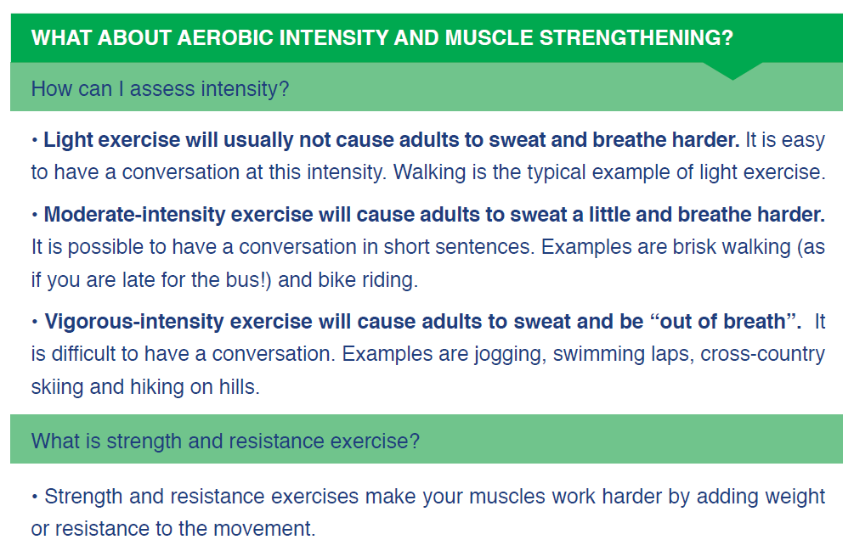

Slide 24
Counseling Opportunities
Comprehensive
Brief
10-20 minutes
Ask
2-4 min
30 seconds

Slide 25
Physical Activity Stage of Change
Are you currently physically active? NO
Do you intend to become more physically active in the next 6 months?
NO
Precontemplation
Get your patient thinking about PA.
Reduce sedentary behaviour.
YES
Contemplation
Encourage patient to start being PA.
Write Exercise Px.
Adapted from:
Marcus, B.H. & Forsyth, L.A. Motivating People to Be Physically Active. 2009, Human Kinetics.
Prochaska, J.O., DiClemente, C.C., & Norcross, J.C. (1992). In search of how people change: Applications to addictive behaviors. American Psychologist, 47, 1102-1114.
Notes:
Suggested Talking Points
1. Assess the behavioral readiness of the patient to exercise and how this assessment should determine the physician’s exercise counseling action.
2. The stage of change model used in EIM is based on the Transtheoretical model of change used in health psychology. EIM has simplified this model for the Physician action guide to make it as easy as possible for the physician to quickly provide the appropriate exercise counseling.
3. Precontemplation – eductating patient

Slide 26
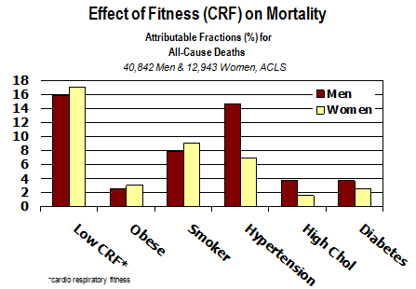
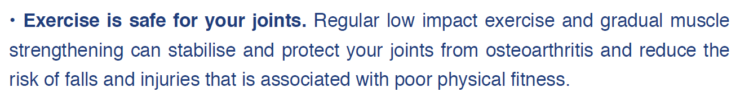
ADVISE - The sceptical patient!
“but I tried to exercise in the past but I never loose weight....”
“but I can’t afford to join a gym...”
“but whenever I exercise my knees start to hurt and I don’t want to damage them....”

Slide 27

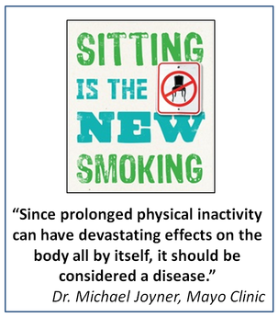
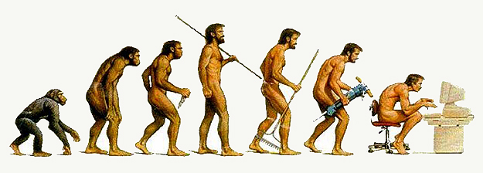
Each hour of TV cuts about 22 minutes from one’s life span,
smokers ~11 minutes/ cigarette.
Kanodia et al., BJSM, 2012

Slide 28
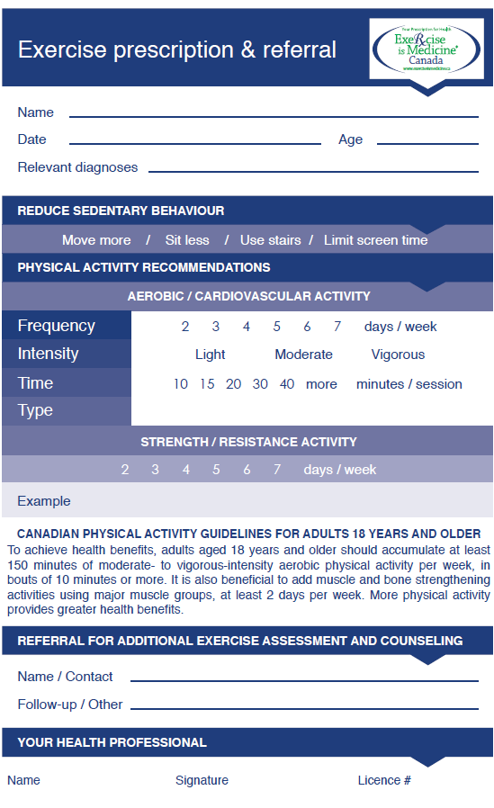

Slide 29
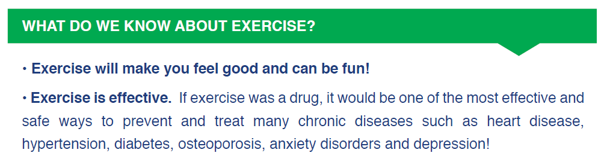
ADVISE – Your patient is receptive to learning more

Slide 30
Physical Activity Stage of Change
Are you currently physically active? YES
Are you engaged in regular PA?
YES
ACTION/MAINTENANCE
Help maintain regular PA.
Acknowledge success.
Encourage regular PA. Write Exercise Px.
Refer to Certified Exercise Professional if necessary.
NO
PREPARATION
Adapted from:
Marcus, B.H. & Forsyth, L.A. Motivating People to Be Physically Active. 2009, Human Kinetics.
Prochaska, J.O., DiClemente, C.C., & Norcross, J.C. (1992). In search of how people change: Applications to addictive behaviors. American Psychologist, 47, 1102-1114.
Notes:
Suggested Talking Points
1. This slide further expands on step #3 of the previous slide. It tells the physician how to assess the behavioral readiness of the patient to exercise and how this assessment should determine the physician’s exercise counseling action.
2. The stage of change model used in EIM is based on the Transtheoretical model of change used in health psychology. EIM has simplified this model for the Physician action guide to make it as easy as possible for the physician to quickly provide the appropriate exercise counseling.

Slide 31
Case 1: Amanda Walker
A 58 year old woman seen for her periodic visit with hypertension as her only known health condition.
Your evaluation reveals good control of her hypertension and no suspected new conditions.
She is about to retire and your PA assessment reveals that she takes a 20-30 min walk with her husband 3-4 times a week.
What would be your exercise prescription?
Notes:
A standard healthy, non-sedentary, non-obese patient that is below the GUIDELINES RECOMMENDATIONS.
Prescription could be anything towards the GUIDELINES RECOMMENDATIONS.
Reaching the GUIDELINES RECOMMENDATIONS is a possible goal for such a patient; including resistance exercise.
A focus on introducing MODERATE INTENSITY activities would be appropriate.
Referral is also an excellent option: Qualified exercise professionals can provide not only exercise counseling but are qualified to optimise motivation.

Slide 32
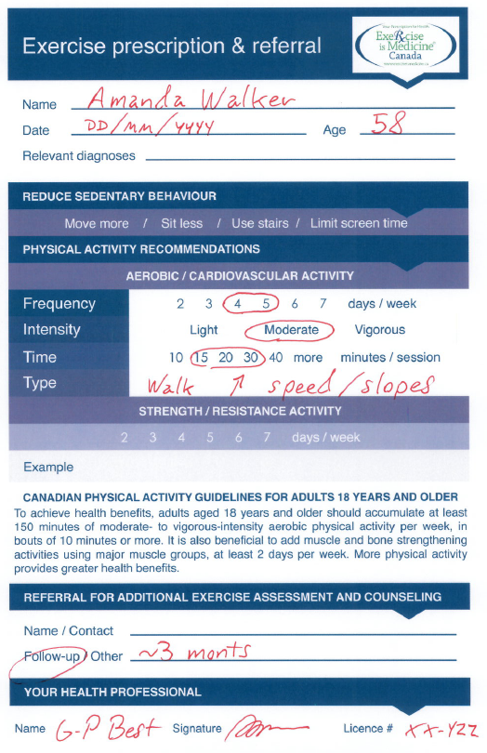
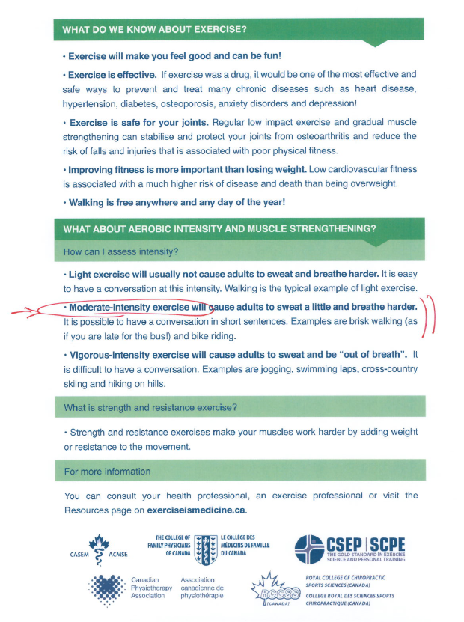
One possible
prescription
for Amanda…
Notes:
A standard healthy, non-sedentary, non-obese patient that is below the GUIDELINES RECOMMENDATIONS.
Prescription could be anything towards the GUIDELINES RECOMMENDATIONS.
Reaching the GUIDELINES RECOMMENDATIONS is a possible goal for such a patient; including resistance exercise.
A focus on introducing MODERATE INTENSITY activities would be appropriate.
Referral is also an excellent option: Qualified exercise professionals can provide not only exercise counseling but are qualified to optimise motivation.

Slide 33
Case 2: John Sweet
A 39 year old man seen for a follow-up following a glucose tolerance test.
He is a computer analyst working 60 hours a week, sedentary and obese (BMI = 33).
His average blood pressure 145/85
His lab results are just below the threshold for dyslipidemia and diabetes diagnosis.
As part of your general counseling regarding metabolic syndrome…
What would be your exercise prescription?
Notes:
A sedentary patient with metabolic syndrome.
Clearly, the GUIDELINES RECOMMENDATIONS level of exercise would be a premature objective for such a patient.
Using counseling about metabolic syndrome and the related potential of healthy living changes to avoid the possible outcomes related to the metabolic syndrome, the exercise prescription should clearly include a focus on sedentary behaviours (and that could be enough initially).
Setting an intermediate level of exercise below GUIDELINES RECOMMENDATIONS would be a good start.
Referral is also an excellent option: Qualified exercise professionals can provide not only exercise counseling but are qualified to optimise motivation.

Slide 34
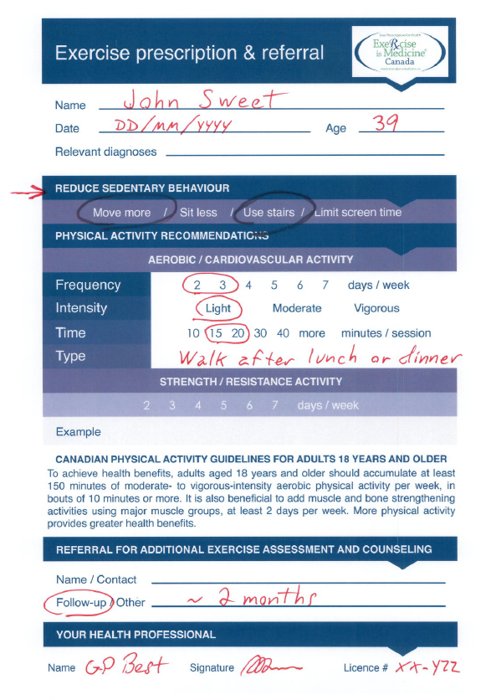
One possible
prescription
for John…
Notes:
A sedentary patient with metabolic syndrome.
Clearly, the GUIDELINES RECOMMENDATIONS level of exercise would be a premature objective for such a patient.
Using counseling about metabolic syndrome and the related potential of healthy living changes to avoid the possible outcomes related to the metabolic syndrome, the exercise prescription should clearly include a focus on sedentary behaviours (and that could be enough initially).
Setting an intermediate level of exercise below GUIDELINES RECOMMENDATIONS would be a good start.
Referral is also an excellent option: Qualified exercise professionals can provide not only exercise counseling but are qualified to optimise motivation.

Slide 35
Case 3: Susan Fitt
A healthy 31 year old teacher seen for her periodic health evaluation and oral contraceptive renewal.
She reports that her IT band syndrome rapidly resolved following your suggestions and that she was able to participate in her first 10 km run last August.
She says she would like to run a half-marathon next year and asks you for counseling on how to prepare for such an objective.
What would be your exercise prescription?
Notes:
A healthy patient that likely exceeds the basic GUIDELINES RECOMMENDATIONS and certainly has an objective that will!
The exercise prescription tool was not designed to support advance counseling for exercise.
In such a situation, if you are not qualified to provide advance counseling (ie: preparation for a half marathon), the tool could still be used for referral.

Slide 36
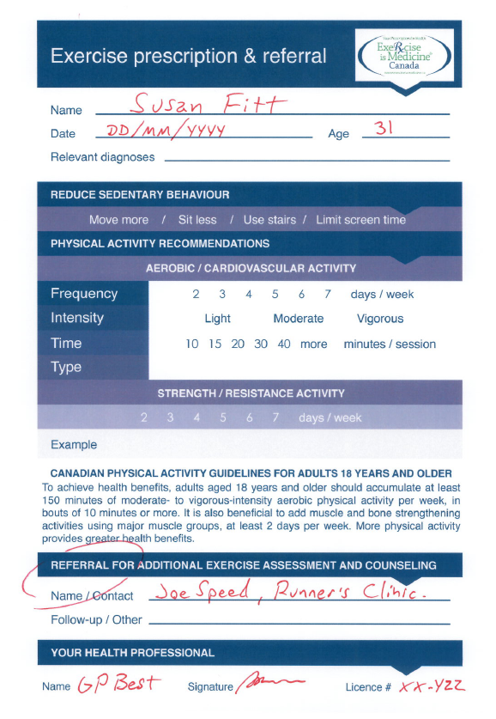
One possible
prescription
for Susan…
Notes:
A healthy patient that likely exceeds the basic GUIDELINES RECOMMENDATIONS and certainly has an objective that will!
The exercise prescription tool was not designed to support advance counseling for exercise.
In such a situation, if you are not qualified to provide advance counseling (ie: preparation for a half marathon), the tool could still be used for referral.

Slide 37
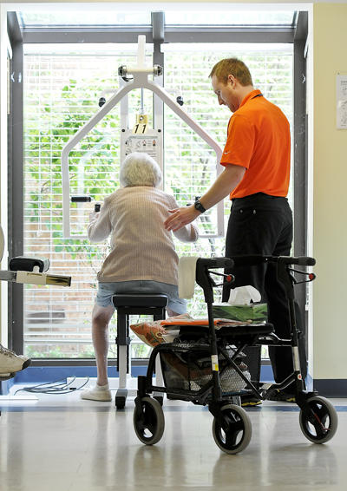
Who can assist you and your patient in the prescription and adaptation of an exercise program?
Who is an exercise professional?

Slide 38
Exercise Professionals
In addition to those regulated health professionals that can receive referrals (e.g. physiotherapists, sport chiropractors):
EIMC Recognition Program: Qualified exercise professionals including:
Canadian Society for Exercise Physiology http://www.csep.ca
  CSEP-CPT; CSEP-CEP
  Registered Kinesiologists, RKin
    Self regulating body in OntarioRegulated Health Professions Act 1991 (RHPA) and the Kinesiology Act, 2007
  American College of Sports Medicine (ACSM)
  EIMC Professional Network and Referral:
  Includes EIMC Recognized exercise professionals and all regulated primary care and specialist professionals.
Notes:
Suggested Talking Points
If the physician determines that a patient is cleared for independent exercise (i.e., the patient is safe to exercise without needing to be monitored by a knowledgeable professional), and the physician would prefer to refer the patient to someone else for exercise counseling rather than writing an exercise prescription themselves, EIM encourages physicians to refer their patients to a certified fitness professional. Currently, we recommend that physicians and members of the public either try to use ACSM-certified health and fitness professionals (through ACSM’s ProFinder) or to go through NCCA-accredited association such as the National Strength and conditioning Association, the American Council on Exercise, the National Academy of Sports Medicine, or the Cooper Institute. In the future, EIM plans on developing a “one-stop shop” type of database for referrals, in which appropriately accredited professionals can opt-in to become part of the EIM network.

Slide 39
EIMC Professional Recognition Program
Helps busy health care professionals identify highly qualified exercise professionals to help their patients meet their physical activity and health goals related to chronic disease prevention, management and treatment.
EIMC Level 1 | EIMC Level 2
CSEP-Certified Personal Trainer (CSEP-CPT) College of Kinesiologists of Ontario Registration (CKO) ACSM CPT + EIM Level 1 ACSM HSF + EIM Level 2 ACSM EIM Level 1 | CSEP Certified Exercise Physiologist (CSEP-CEP) College of Kinesiologists of Ontario Registration (CKO) ACSM CES ACSM RCEP ACSM EIM Level 2 ACSM EIM Level 3
Asymptomatic individuals with a single controlled chronic condition (i.e. low, mod, high risk cleared for independent exercise | Clients at high risk and those with > 1 chronic disease or who may require clinical monitoring
Notes:
An important new initiative showcasing the scope of EIMC!
How do I know which EIMC Professional Level to refer to?
EIMC Patient Categories:
A. Apparently healthy individuals with no constraints for regular participation in physical activity and exercise;
B. Asymptomatic individuals with a single chronic disease/condition controlled with physician-prescribed therapies; and
C. Patients who have a higher risk than those in categories A and B above including those who have more than one chronic disease or who may require clinical monitoring during exercise.
EIMC Level I recognized professionals can safely and effectively prescribe physical activity to patients in categories A and B. The benefits of physical activity outweigh any risks.
EIMC Level II recognized professionals have advanced knowledge and expertise in exercise management for those with chronic disease. Level II EIMC recognized professionals can safely and effectively work with patients in categories A, B and C.
Those <15 -years or >69- years require annual physician clearance in order to provide fitness assessments, design, implement, and monitor client-tailored submaximal exercise programs to such persons.
Note: Planned changes to the CSEP-CPT scope of practice will modify the current requirements for annual physician completion of the Physician Physical Activity Readiness Clearance Form.
ACSM-HFS,= ACSM Health Fitness Specialist
ACE Advanced Heath Fitness Specialist ACE = American Council on Exercise Health Fitness Specialist
ACSM-CES, = ACSM Clinical Exercise Specialist
ACSM-RCEP, = ACSM Registered Clinical Exercise Physiologist

Slide 40
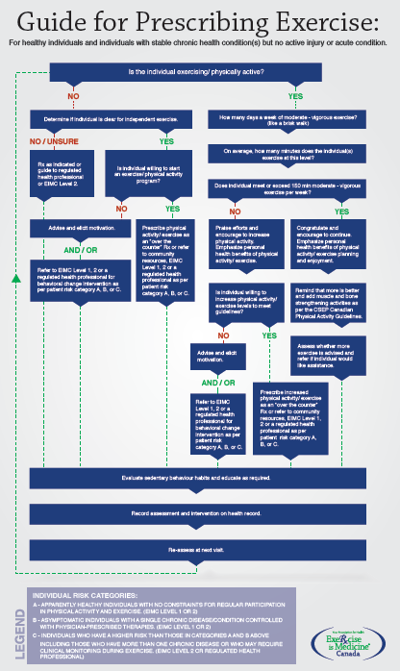
Other resources to support exercise prescription:
Consult the
« Guide for prescribing exercise »
that will be available very soon at:
www.exerciseismedicine.ca

Slide 41
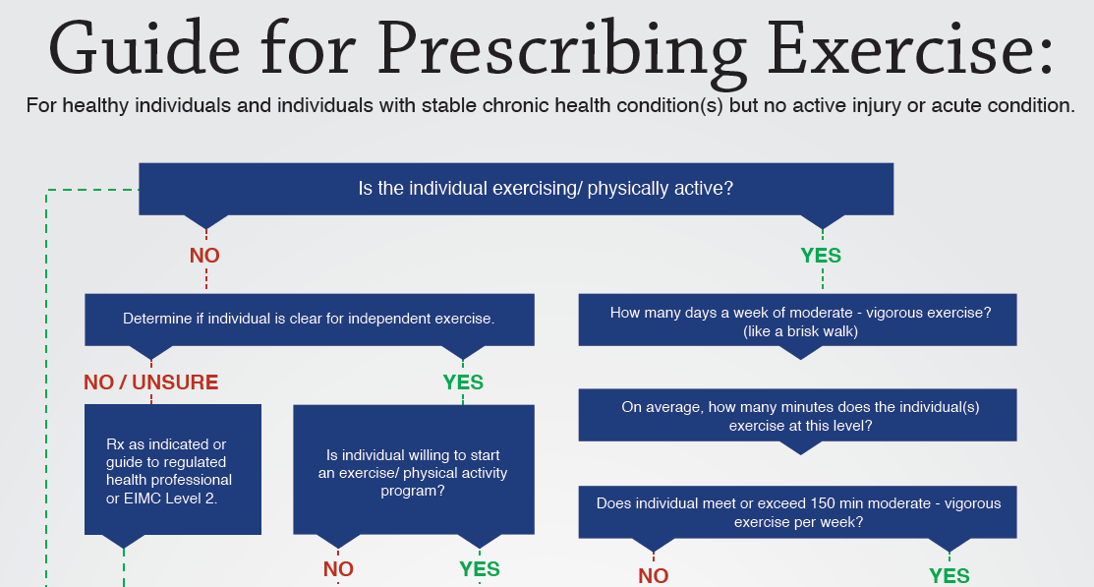

Slide 42
Counseling Opportunities
Comprehensive
Brief
10-20 minutes
Ask
2-4 min
30 seconds

Slide 43
The equation for Success:
A + S = R

Slide 44
SUMMARY
Exercise Vital Sign – ASK EVERY PATIENT EVERY TIME !
Educate your patient that exercise is good medicine.
For most patients, exercise is an over the counter medication.
Assist and support your patient in the behaviour change process.
Individualize your Exercise Px to the patient.

Slide 46

Acknowledgements
I would like to acknowledge the following for their contributions to this presentation:
  Dr. Jonathon Fowles, PhD, CSEP-CEP
  Dr. R. Frankovich, MD, FCFP, DipSportMed
  Dr. P. Frémont, MD, PhD, CCFP, DipSportMed
  Sue Boreskie, MPE
  Michelle Fortier, PhD
  Susan Yungblut, BScPT, MBA, Director, EIMC
  exerciseismedicine.ca

Slide 47
Support EIMC – Join the EIMC Professional Network
Visit exerciseismedicine.ca /
EIMC Professional Network
Notes:
47

Slide 48
Support EIMC – Join the EIMC Professional Network
Certificate for client care area
Use of EIMC prescription pad
Use of EIMC Professional network logo for professional communications materials
Monthly e-newsletter
Reduced rates on educational offerings
2nd phase online networking and referral database
$60 annual fee ($50 CSEP members)
Notes:
48

Slide 49
EIMC Professional Network
Integrates regulated health care professionals and EIMC Recognized exercise professionals for referral and networking.
EIMC Supporter | EIMC Provider
Support the EIM philosophy Ask every patient, every time about personal physical activity level Work with patients to help them achieve their physical activity and health goals through: education about the importance of physical activity to health, advice and referral for additional assessment and counselling. | Support the EIM philosophy, Ask every patient, every time about personal physical activity levels, Work with patients to help them to achieve their physical activity goals and thus optimize their physical and mental health, through: assessment, advice, education about the importance of physical activity to health, counseling strategies for behavior change, exercise instruction and supervision and referral as required. Willing to accept patient referrals from other health care professionals for continued physical activity counseling and prescription.
Notes:
An important new initiative showcasing the scope of EIMC!
How do I know which EIMC Professional Level to refer to?
EIMC Patient Categories:
A. Apparently healthy individuals with no constraints for regular participation in physical activity and exercise;
B. Asymptomatic individuals with a single chronic disease/condition controlled with physician-prescribed therapies; and
C. Patients who have a higher risk than those in categories A and B above including those who have more than one chronic disease or who may require clinical monitoring during exercise.
EIMC Level I recognized professionals can safely and effectively prescribe physical activity to patients in categories A and B. The benefits of physical activity outweigh any risks.
EIMC Level II recognized professionals have advanced knowledge and expertise in exercise management for those with chronic disease. Level II EIMC recognized professionals can safely and effectively work with patients in categories A, B and C.
Those <15 -years or >69- years require annual physician clearance in order to provide fitness assessments, design, implement, and monitor client-tailored submaximal exercise programs to such persons.
Note: Planned changes to the CSEP-CPT scope of practice will modify the current requirements for annual physician completion of the Physician Physical Activity Readiness Clearance Form.
ACSM-HFS,= ACSM Health Fitness Specialist
ACE Advanced Heath Fitness Specialist ACE = American Council on Exercise Health Fitness Specialist
ACSM-CES, = ACSM Clinical Exercise Specialist
ACSM-RCEP, = ACSM Registered Clinical Exercise Physiologist

Slide 50
