Slide 1
Geriatrics at the office: clinical cases
Dr Raphaëlle Thériault, MD, CCFP, COE
June 6th 2015

Slide 2
I have no disclosures

Slide 3
Case #1: Ms M
79 y.o. women, lives at home in Sainte-Marie
Husband passed away 2 months ago (stroke)
Comes with her daughter (who is also your pt)
RC: Hypertension f-u
When leaving her daughter tells you…
“I’m scared my mom has caught Alzheimer's!”

Slide 4
Option A: Geriatric consult
Option B: Apt in 3 weeks

Slide 5
3 weeks later…
Short term memory loss x 1 y
Progressive
Language is preserved
No hallucinations/delusions
No problems with gait or balance

Slide 6
IADLs:
Cooking ok but making smaller meals
Cleaning and laundry ok
Forgetful with medication
Does not drive
Daughter takes care of finances x 2 months
ADLs: ok

Slide 7
PMH: Osteoporosis, HTN, GERD, Anxiety
No alcohol or smoking
Medications:
HCTZ 25 mg die
Coversyl 4 mg die
Calcium 500 mg bid
Vit D 1000U die
Tecta 40 mg die
Celexa 20 mg die
Ativan 1 mg tid and 1 mg HS

Slide 8
PE:
Heart, lungs, abdo normal (done last apt)
Neuro summary
CN n
Finger-nose n
Tone, strength, reflexes n
Sensitivity n
Gait n
MMSE 21/30 (4/5, 0/3)

Slide 9
Lab tests
CBC, creat, E+ n
TSH n
Vit B12 n
CT scan?

Slide 10
Diagnosis?
Alzheimer’s Dementia

Slide 11
Treatment
Plan:
Wean Ativan over 1 year
Donepezil 5 mg die x 1-3 months then increase to 10 mg die
Non-pharmacologic:
Physical activity
Balanced diet
Cognitive stimulation
Social stimulation
POA, will
Alzheimer society
In home help

Slide 13
Case #2: M. S
72 y.o. male, lives in a house in Moncton with his wife and son
Comes alone
RC: falls

Slide 14
History
4 falls in 6 months
Different every time, according to pt loss of balance
No cardiac sx, no dizziness, no focal neuro sx and no sx suggestive of seizure
Feels slowed-down and stiff

Slide 15
PMH: Hypothyroidism, insomnia, B12 deficiency, DLPD, bipolar disease, CRF
Past alcohol abuse, does not smoke
Medication:
Synthroid 75 mcg die
Serax 15 mg HS
Lipitor 20 mg die
Zyprexa 5 mg die
B12 1200 mcg PO die

Slide 16
PE
Vitals n
Heart, lungs n
Neuro
PERL
CN n
RAM fingers and hands slower L>R
Tone: Rigidity UL L>R, cog wheeling
Strength 5/5 UL and LL, reflexes n
Gait: trunk flexion, small steps, loss of arm swing, no freezing
Sensitivity ok
No tremor

Slide 17
Diagnosis
???

Slide 18
More information…
Lithium changed for Zyprexa 9 months ago 2nd CRF
Zyprexa progressively increased
TSH normal
B12 normal
CBC normal

Slide 19
Plan
Call psychiatrist…apt next week
Zyprexa changed for Valproic acid
Close follow-up in psychiatry over next months

Slide 20
2 months later
No falls in last month, pt feels less stiff, balance better
Still finds himself slowed-down
PE:
Rigidity improved but still cog wheeling on L
Slight bradykinesia persist
Gait: less trunk flexion, steps better, pt has bought a 4WW for long distances

Slide 21
Diagnosis?
Parkinson’s disease

Slide 22
Treatment
If symptoms disturbing enough, Sinemet 25/100 mg 1 tab daily x 1 week then 1 tab bid
Close f-u
Eventually 1 tab qid or more
Ideally day hospital, follow-up of parameters by physio

Slide 23
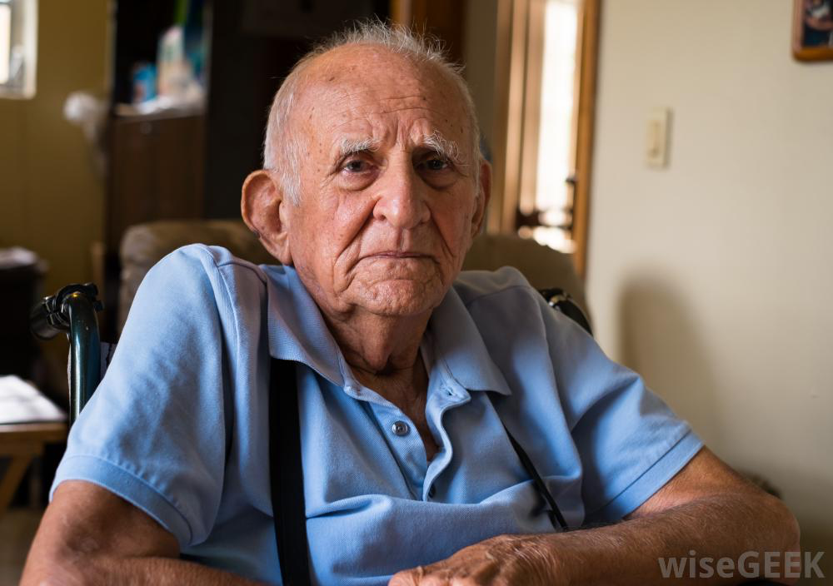
Case #3: M. O
82 y.o. man, level 2 residency x 4 months
PMH: COPD, OA, GERD, HTN, CAD
Past alcohol abuse? Smokes 2 packs/day
RC: Cough

Slide 24
History:
Difficult to get clear history from pt, done with help of care worker
Cough + green sputum x 5 days
Slightly short of breath
Fever (38.8), sat 88%
PE suggestive of right base pneumonia
X-ray confirms
Admission at emerg, IV ATB
Isolation for Influenza pending

Slide 25
48h later…
Pt still in emerg., very agitated last night, verbally and physically aggressive with staff, thinks he is at his residence
Transferred to palliative care (only bed available)
Bothering other patients +++
1 mg qid PRN of Ativan prescribed

Slide 26
Diagnosis?
DElirium!

Slide 27
Risk factors
Change in his environment
Isolation…masks and gowns
No windows
Changes in medication
Potential withdrawal
Baseline cognitive decline

Slide 28
PE
Nothing particular

Slide 29
Lab tests
CBC: normal
Renal function/E+: normal
TSH: normal
Trops: 0,050 (n<0,034)
Procalcitonine: 0,18
Influenza: negative
Urine analysis: normal
Last BM: none since admission

Slide 30
Cause?
Pneumonia
Constipation
Nicotine withdrawal

Slide 31
Causes…

Slide 32
Treatment
D/C Ativan
Nicotine withdrawal protocol with regular nicotine inhaler
Seroquel 12.5-25 mg PO bid reg. and 12.5 mg PO bid PRN
Peg daily x 3 days
Walk patient 3 times/day

Slide 33
Pt becomes more calm 5 min post nicotine inhaler
Progressive resolution of confusion over the next 5 days
Baseline cognitive deficits remain

Slide 34
Case #4: Ms B
87 y.o. woman, accompanied by her daughter
PMH: HTN, DM 2, DLPD, CAD (MI 1994), Anxiety, mixed type dementia, osteoporosis, GERD, osteoarthritis
RC: dizziness

Slide 35
Dizziness only when she gets up, very suggestive of orthostatic hypotension
Lives with her daughter, completely dependant for IADLs, needs help with bathing, will dress with guidance, walks with walker, some urinary incontinence
Often thinks her daughter is her sister
No behavioral problems

Slide 36
PE
BP: 112/65 (sitting), 88/53 (standing)
HR: 58
Rest normal
Blood sugars: 5.5-8.2 (2 hypoglycemias in last month)

Slide 37
Medications
HCTZ 25 mg die
Coversyl 4 mg die
Metoprolol 50 mg bid
Insuline NPH 10 U HS
Metformin 1000 mg bid
Diamicron 60 mg bid
Lipitor 40 mg die
ASA 81 mg die
Ranitidine 75 mg bid
Vit D 1000U die
Calcium 500 mg bid
Alendronate 70 mg/w
Rivotril 0.5 mg bid
Celexa 40 mg die
Aricept 10 mg die
FeSO4 300 mg die
Vit B12 1200 mcg die
Tylenol arthritis 650 mg bid
Senokot die PRN

Slide 38
Stop,
decrease or continue?

Slide 39
Medication
HCTZ 25 mg die
Coversyl 2 mg die
Metoprolol 25 mg bid
Insuline NPH 10 U HS
Metformin 1000 mg bid
Diamicron 60 mg bid
Lipitor 40 mg die
ASA 81 mg die
Ranitidine 75 mg bid
Tecta 40 mg die
Vit D 1000U die
Calcium 500 mg bid
Alendronate 70 mg/w
Rivotril 0.25-0.5 mg (bid)
Celexa 20 mg die
Aricept 10 mg die
FeSO4 300 mg die
Vit B12 1200 mcg die
Tylenol arthritis 650 mg bid
Senokot die PRN

Slide 40
Care Plan
Code
ATB
Comfort care vs. palliative care

Slide 41
Thank you!

