Slide 1
Baffled, Befuddled, and Bemused
How not to get fooled again, and again, and ,…
Tina Korownyk
Associate Professor University of Alberta Assistant Director Evidence and CPD Program ACFP

Slide 2
Faculty/Presenter Disclosure
Faculty/Presenter: Christina Korownyk
Relationships with commercial interests:
Pay from U of A and Alberta Health
Research and Speaking Fees
  Non-Profit Sources (Alberta College of Family Physicians, TOP, Primary care networks, etc)
  No funding from industry

Slide 3
Mitigating Potential Bias
Information/recommendations provided in the following presentation will be evidence- and/or guideline-based and opinions of the speaker will be identified as such. Recommendations made are evidence- or guidelines-based rather than personal recommendations of the presenter
  All data has been sourced from evidence that is clinically accepted.
  Information presented is evidence-based.
  All support used in justification of patient care recommendations conform to generally accepted standards.
Notes:
This slide must be visually presented to the audience AND verbalized by the speaker.

Slide 4
A Medical Tale: The Surrogate Heart
Once upon a time,..
In a Kingdom Far, Far away,…
It was noticed abnormal beats follow Heart Attacks
More beats = ↑ risk of Sudden Death
The King said: “Give a potion to decrease extra beats and thou shalt increase survival”
And So they did,…

Slide 5
A Medical Tale: The Surrogate Heart
And it was good,… until
A Jester asked: “Are we saving lives?”

Slide 6
A Medical Tale: The Surrogate Heart
After the execution, the King asked his people to solve the riddle
So, they gave the magic potion to some and not to others
After 10 months

Slide 7
A Medical Tale: The Surrogate Heart
 | X (730) | Y (725)
Mortality | 56 (7.7%) | 22 (3.0%)
arrhythmia death or cardiac arrests | 33 (4.5%) | 9 (1.2%)
i. NEJM 1989; 321(6): 406-12

Slide 8
A Medical Tale: The Surrogate Heart
 | Treatment (730) | Placebo (725)
Mortality | 56 (7.7%) | 22 (3.0%)
arrhythmia death or cardiac arrests | 33 (4.5%) | 9 (1.2%)
The Number Needed to Harm (kill) 1 extra patient was only 21.
i. NEJM 1989; 321(6): 406-12

Slide 9
Outcomes: Surrogate, Subjective, Objective
Ask yourself: Can a patient feel the outcome?
If No; it is a surrogate marker

Slide 10
Surrogates: The Never-ending Story
The Treatment
•Torcetrapib
•Niacin
•Ezetimibe
•Atenolol
•Doxazosin
•Aliskerin
•Rosiglitazone
•Almost any diabetes medications except Metformin
•Vitamin E, Rosiglitazone, etc.
The Marker
•HDL
•LDL
•BP
•A1C
•CRP in CVD
HDL: N Engl J Med 2007;357:2109-22. November 5, 2012, at NEJM.org. Niacin: N Engl J Med. 2011;365(24):2255-67. Ezetimibe: Tools for Practice, March 29, 2010. Atenolol: Lancet 2004; 364: 1684–89.
Doxazosin: JAMA 2000; 283: 1967- 1975. Aliskerin N Engl J Med. 2012 Dec 6;367(23):2204-13.Rosi: Tools for
Practice October 4 2010 CRP: PLoS Med 2010; 7(2): e1000196

Slide 11
How Drugs Work?

Slide 12
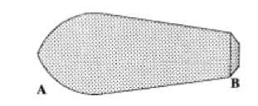

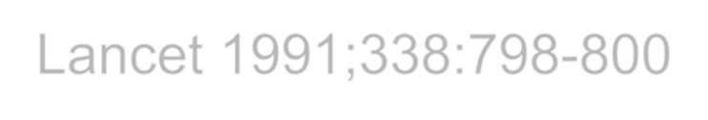
WHERE DO SUPPOSITORIES FIT IN?
DO YOU INSERT THE A OR B END FIRST?
Lancet 1991;338:798-800

Slide 13

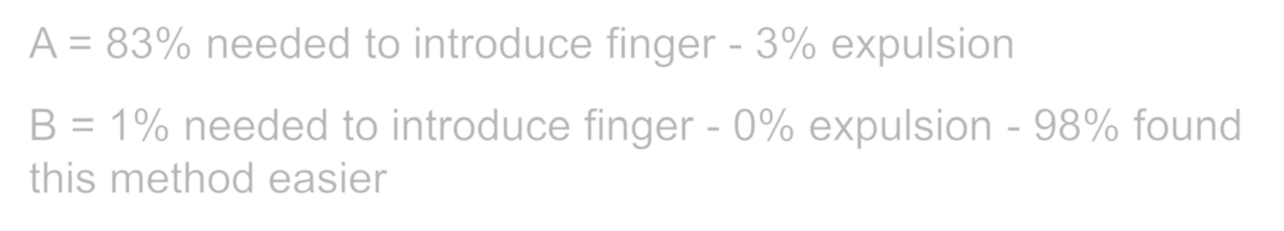
WHERE DO SUPPOSITORIES FIT IN?
DO YOU INSERT THE A OR B END FIRST?
A = 83% needed to introduce finger - 3% expulsion
B = 1% needed to introduce finger - 0% expulsion - 98% found this method easier
Lancet 1991;338:798-800

Slide 14
We have no real idea why,…
This stuff works
•Lithium for Bipolar
•Vitamin D for Falls
•Nitro patches for tendinopathy
•Nifedipine for renal stones
•Most drugs really
This stuff doesn’t (Other wrong theories)
•Oral HRT for incontinence
•Anti-oxidants
•Cough Meds in kids
•Febrile seizure antipyretics
•Plus the non-drug theories
Analgesia in Abdo pain
Lubricant on a speculum

Slide 15
Understanding Statistics?

Slide 16
Risk: Relative, Absolute & NNT
If you don’t know where you start, it’s hard to know where you finish.
Zoster Vaccine reduces shingles up to 70%
Study | Placebo | Zoster Vac | Benefit | NNT (3 yrs)
Age 50-59 (3 yrs) | 2.03% | 0.62% | 1.41% | 71
Age ≥60 (3 yrs) | 3.42% | 1.67% | 1.75% | 58
Bottom-Line: Over 3 years, one in 60-70 patients will avoid shingles due to the vaccine
- One in 350 for post-herpetic neuralgia.
Tools for Practice Nov 12, 2012.

Slide 17
Statistical Significance & Confusion Intervals.

Slide 18
Novel
Anti-Coagulants
1.2
1
“ARISTOTLE: A major win for apixaban in AF”
“the most positive yet”
“first of the three new oral anticoagulants to show a clearly significant reduction in all-cause mortality”
0.8
0.6
High CI
low CI
Point Estimate
0.4
0.2
0
Apixaban
Dabigatran
http://www.theheart.org/article/1268723.do, Dabigatran (150mg): N Engl J Med
2009;361:1139-51.
Apixaban: N Engl J Med. 2011;365(11):981-92

Slide 19
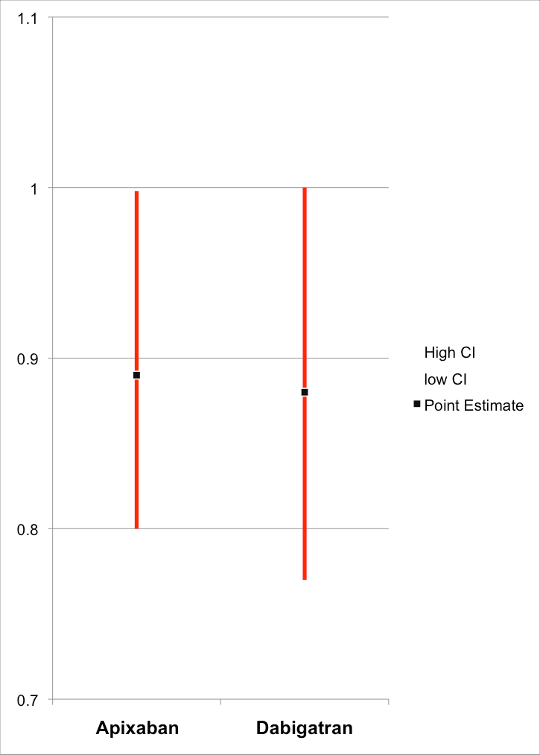
Novel
Anti-Coagulants
Magnified 3x
“ARISTOTLE: A major win for apixaban in AF”
“the most positive yet”
“first of the three new oral anticoagulants to show a clearly significant reduction in all-cause mortality”
http://www.theheart.org/article/1268723.do, Dabigatran (150mg): N Engl J Med
2009;361:1139-51.
Apixaban: N Engl J Med. 2011;365(11):981-92

Slide 20
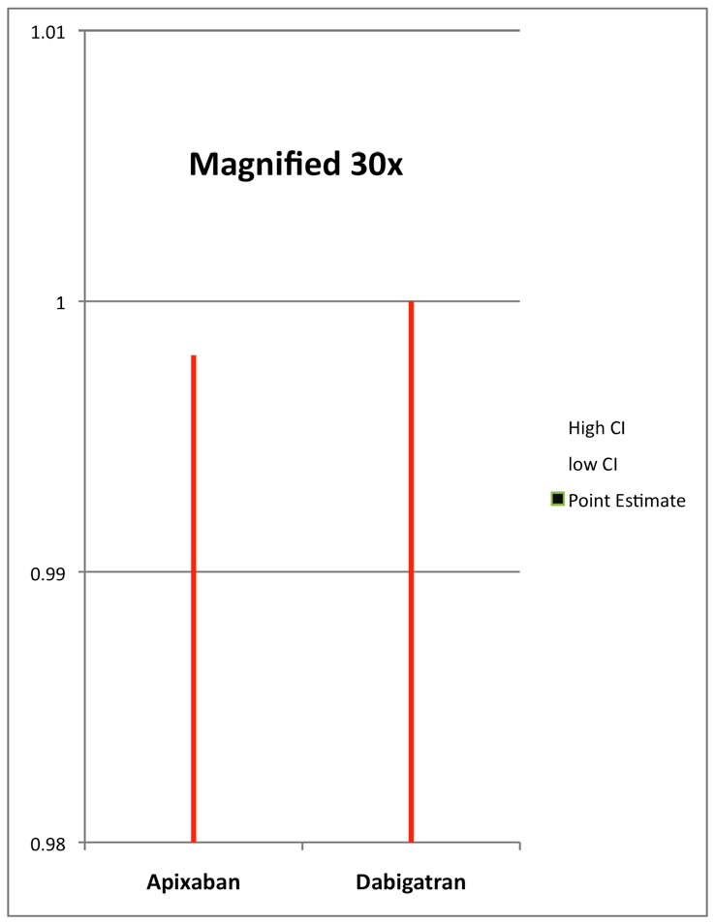
Novel
Anti-Coagulants
“ARISTOTLE: A major win for apixaban in AF”
“the most positive yet”
“first of the three new oral anticoagulants to show a clearly significant reduction in all-cause mortality”
http://www.theheart.org/article/1268723.do, Dabigatran (150mg): N Engl J Med
2009;361:1139-51.
Apixaban: N Engl J Med. 2011;365(11):981-92

Slide 21
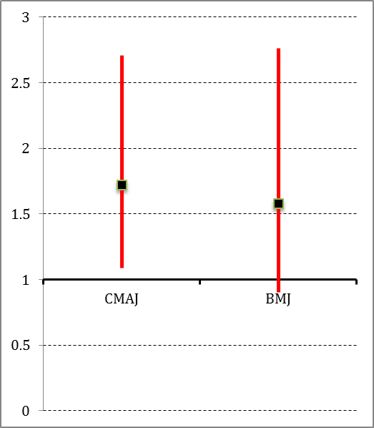
Varenicline & CVD Risk
2 meta-analysis: CMAJ¹ Yes, BMJ No²
– Odds ratio: CMAJ 1.72 (1.09-2.71) & BMJ 1.58 (0.90-2.76)
• NNH = 60 – 600+
– Depend on baseline risk
  If high risk, may consider other options first
1) CMAJ. 2011;183:1359-66. 2) BMJ. 2012;344:
e2856. 3) Ann Intern Med. 2011; 155(4): JC 4-5.

Slide 22
Meta-Analysis: Don’t swallow Mystery Meat?

Slide 23
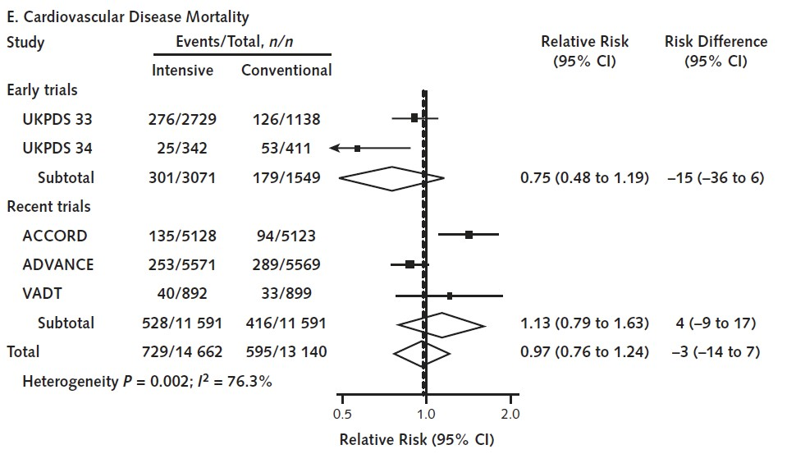
Diabetes: Apples and Oranges

Slide 24
Diabetes: Apples and Oranges
A
⬇
B
⬇

Slide 25
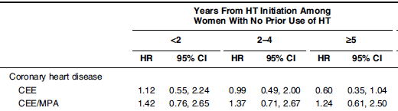
6 tests
Am J Epidemiol. 2009 Jul 1;170(1):12-

Slide 26
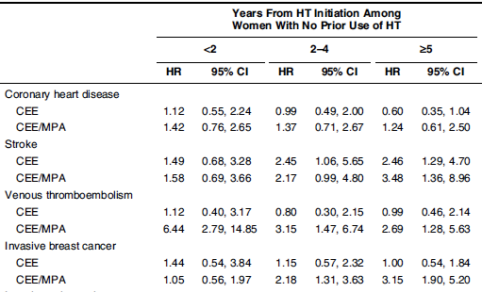
24 tests

Slide 27
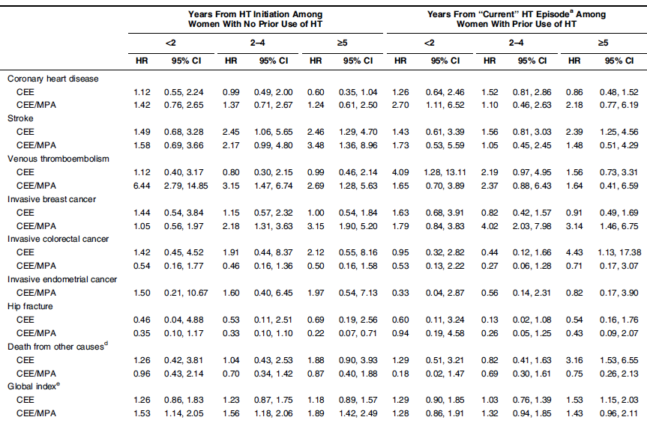
114 tests

Slide 28
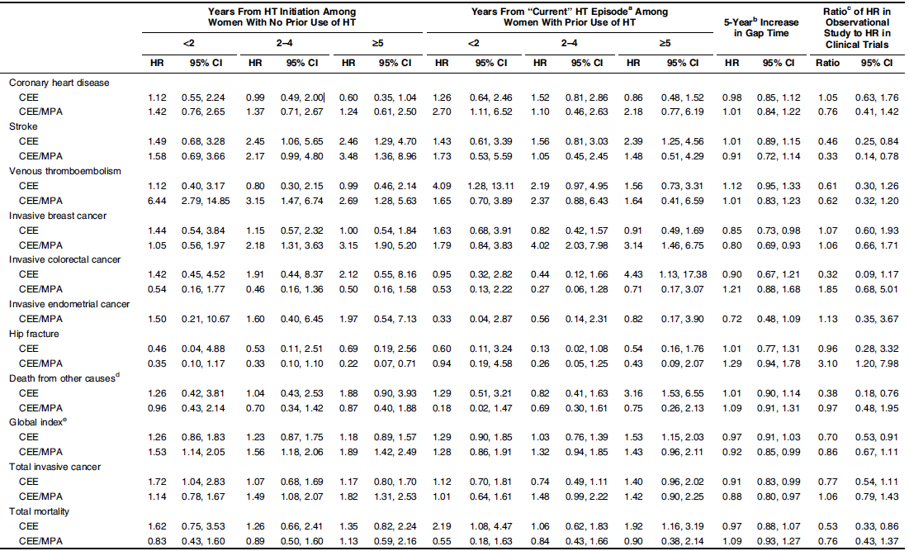
168 tests

Slide 29
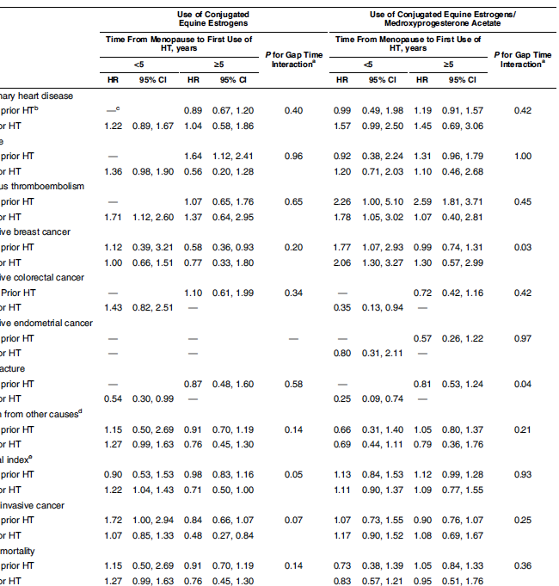
250+ tests

Slide 30
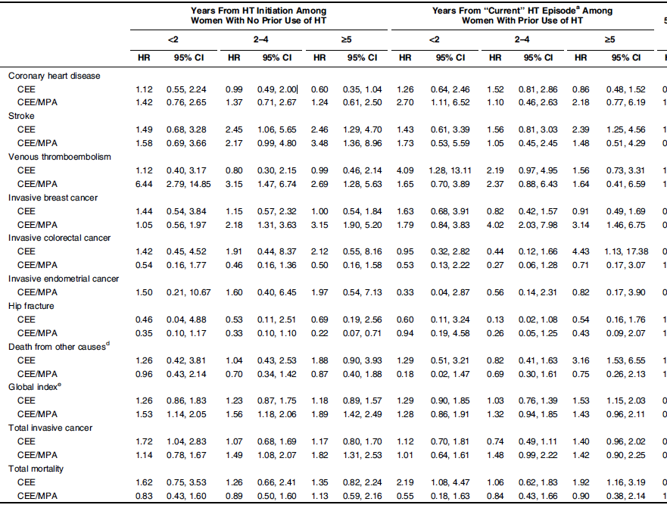
400+ tests

Slide 31
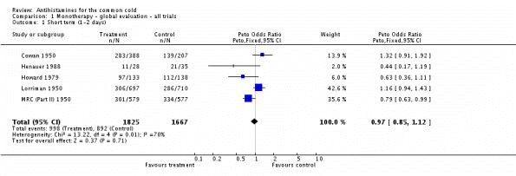
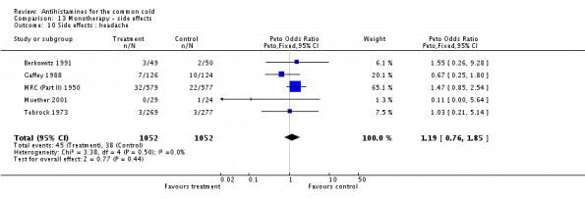
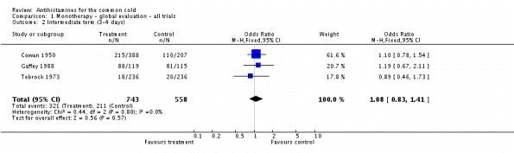
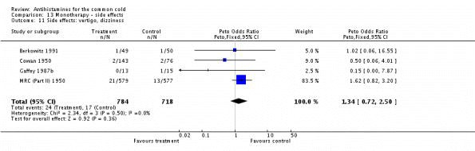
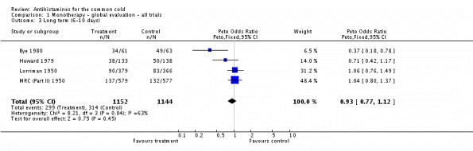
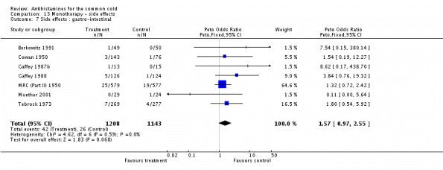
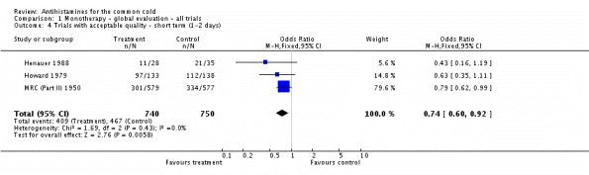
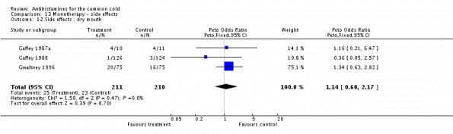
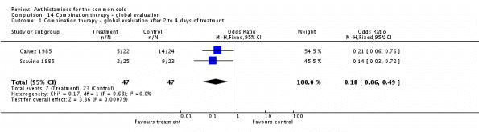
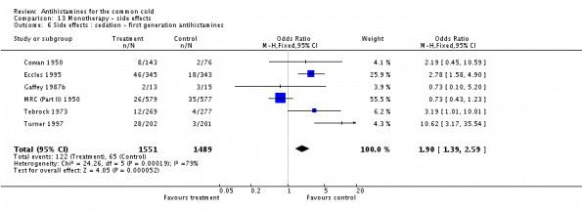
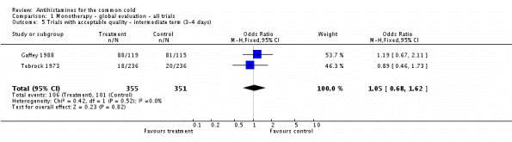
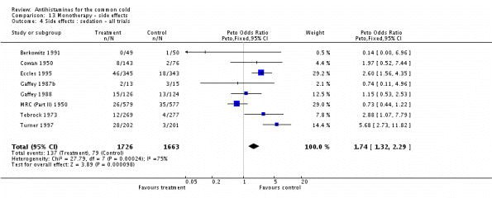
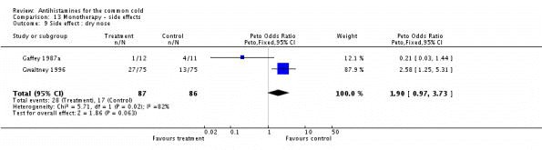
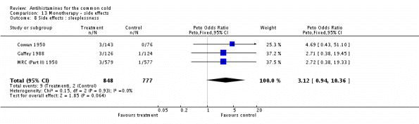
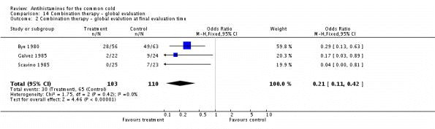
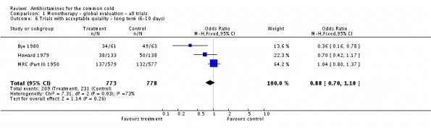
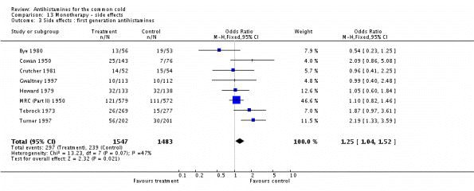
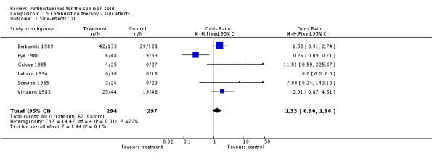
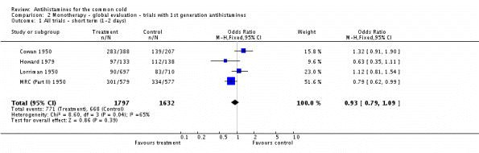
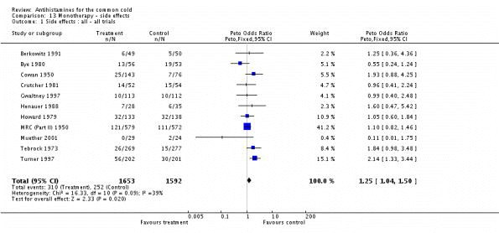
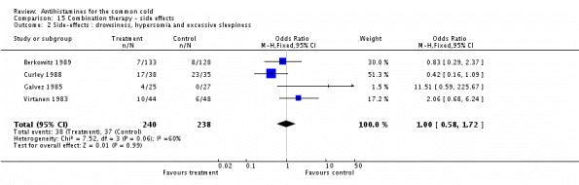
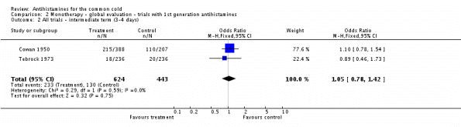
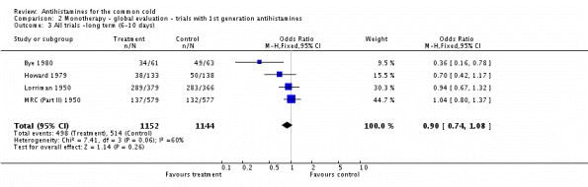
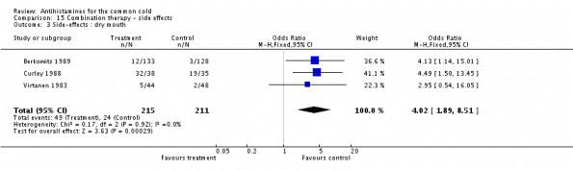
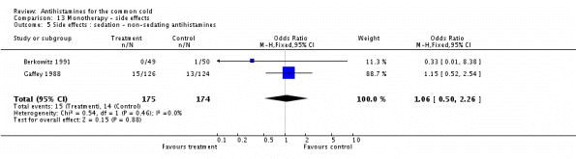
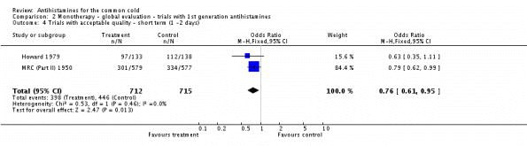
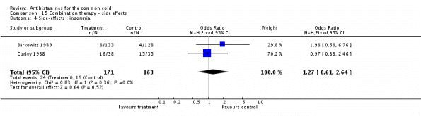
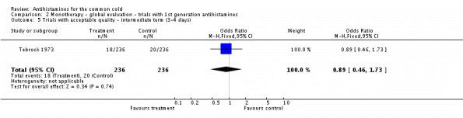
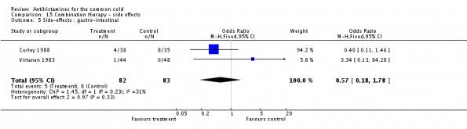
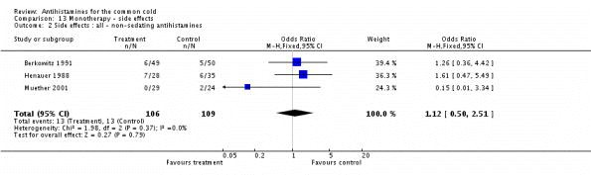
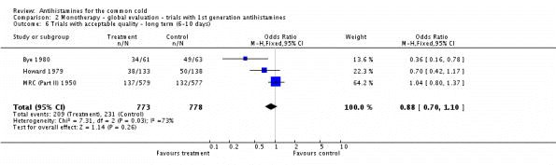
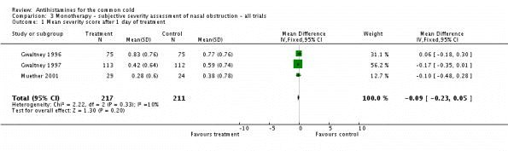
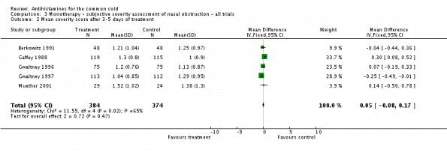
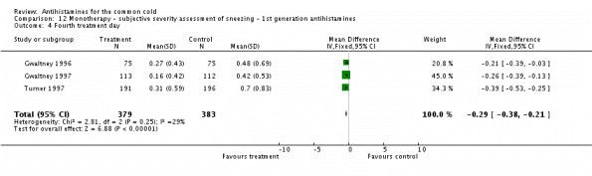
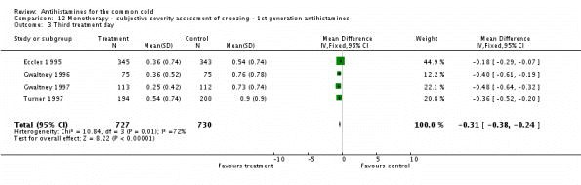
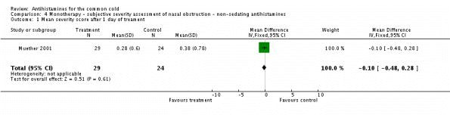

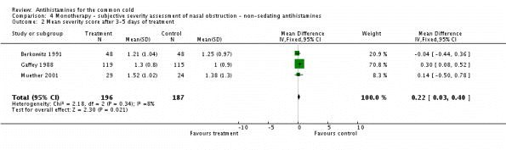























Ways of Measuring A Runny Nose

Slide 32
It’s on a Need to Know Basis

Slide 33
Understanding Funding Bias
However, Funding gives an OR of 4-5.3 that,²
  Study outcomes favor therapy studied
  Therapy is recommended as Treatment of Choice
– Odds Ratio: 5.0 (2.1-12.0)
How do they do it? And an example.
1) BMJ, 2003; 326: 1167-70 Ann Intern Med. 1996 Mar 1;124(5):485-9. 2) JAMA, 2003;
290(7): 921-8. BMJ, 2003; 326: 1167-70. CMAJ 2004;170(4): 477-83.

Slide 34


Even Objective Outcomes are Subjective:
Seeing with Rosi-coloured Glasses
Food and Drug Administration. Briefing document: July 13-14, 2010 meeting of the Endocrinologic and Metabolic Drugs Advisory Committee. (Accessed August 6, 2010)

Slide 35
SSRI: Super Selective Release of Information
94% of all published SSRI trials are positive.
So why do they not work as well in practice,….
Step 1, Hide Bad Trials
Of 74 Trials SSRI/SNRI trials submitted to FDA:
  38 Positive: 37 published
  36 Negative: 14 published (11 as positive).
NEJM 2008; 358: 252.

Slide 36

SSRI: Super Selective Release of Information
Step 2: Re-publish the good!
– Three Trials find their way into 12 publications (5 each)
Melander H, Ahlqvist-Rastad J, Meijer G, Beermann B. Evidence b(i)ased medicine--selective reporting from studies sponsored by pharmaceutical industry: review of studies in new drug applications. BMJ. 2003 May 31;326(7400):1171-3.

Slide 37
Other: Selective Publication (& reporting)
Gabapentin¹
  8 of 20 pain trials not published (40%)
  122 of 180 outcomes never reported (68%)
But lots more:
  60-67% of trials never published²
  Even in public funded research, incomplete outcome reporting common (40% do it)³
N Engl J Med 2009;361:1963-71. 2) BMJ 2005;331:19.
Emerg Med
(Fremantle).2001;13:460-4.
Radiology. 2004;232:101-6. 3) CMAJ 2004;171:735-40

Slide 38
The Bias of “predisposition”
1262 vascular prevention patients.¹
  Carotid plaque increased with increasing yolks eaten
    Not similar to smoking (as in press): 180 vs 250mm²
  Concerns: Surrogate endpoint, select population, life-time consumption from 1 survey, COI (authors write² on risk of eggs or are “vegans”⁵), unclear assessment blinding
Multiple cohort studies with real outcomes,
  8 observational studies (1 big cohort): no risk³
  Newer cohorts also no CVD risk⁴
    Maybe some inconsistent mortality at highest or with DM.
Bottom-line: No convincing evidence eggs are harmful
1) Spence JD Atherosclerosis 2012 Aug 1 epub. 2) Can J Cardiol 2010;26(9):e336-e339. 3) J Am Coll Nut 2004; 23: 596S–600S. 4) Br J Nutr. 2006;96:921-8. Am J Clin Nutr. 2008;87:964-9. Med Sci Monit. 2007;13:CR1-8. 5) http://www.huffingtonpost.com/david-katz-md/eggs-health_b_1818209.html

Slide 39


Publishing with Purpose!
Postgraduate medicine, 2009, 121(1): 73-85.

Slide 40
be avoided with progesterone. Conclusion:Physiological data and clinical outcomes demon­ strate that bioid entical honnones are associated with lower risks, includ ing the risk of breast cancer and cardiovascu lar disease, and are more efficacious than their synthetic and animal­ derived counterparts.Until evidence is found to the contrary, bioidentical hormones remain the preferred method of HRT. Further randomized controlled trials are needed to delineate these differences more clearly.

Slide 41
be avoided with progesterone. Con
strate that bioidentical hormones ar
'" "'"""'' Pk 'Ucio l o .oi
,, clinical outcomes demon­ eluding the risk of breast
associated with lower risks
cancer and cardiovascular disease, and more efficacious an their synthetic and animal­ der:i-ved countemart-S-1.Jnti.Levidence is found to the contrary, bioidentical hormonesremain the preferred method of HRT urther randomized controlled trials are needed to delineate these
1 erences more c ear y.

Slide 42
be avoided with progesterone. Con '" "'"""'' Phuorol o .oi c<> U-<>-t-<>-<>-" clinical outcomes demon­ strate that bioidentical hormones ar associated with lower risks eluding the risk of breast cancer and cardiovascular disease, and more efficacious an their synthetic and animal-
-der:i-ved-c,n1ntemart. ntilevidence is found to the contrary, bioidentical hormonesremain the preferred method of HRT urther randomized controlled trials are needed to delineate these
1 erencesmore c ear y.
Conflict of Interest Statement
Kent Holtorf, MD discloses no conflicts of interest

Slide 43
Revisiting the “affiliation”

Slide 44



Revisiting the “affiliation”

Slide 45
Target Shooting

Slide 46
You can’t be too rich or too low
Blood pressure, Lipids, A1C, weight, rate control AND doses
All, when elevated, are linked to increase risk.
So, getting them back to “normal” is the answer

Slide 47
You can’t be too rich or too low: Targets
Lipids: NO studies look at getting patients to different lipid levels
BP¹: Evidence for 130/80 is inconsistent,
  Even in diabetes, renal disease, or existing CVD.
A1C²: Best case 10-15% ↓ CVD, BUT
  Aggressive reduction ↑ mortality
  For severe hypoglcemia NNH=15-52.
Rate Control³: No difference if <80 or <110 Heart Rate
1) Cochrane Database of Systematic Reviews 2009, Issue 3. Art. No.: CD004349. N Engl J Med. 2010 Apr 29;362(17):1575-85. Lancet 2009; 374: 525–33. N Engl J Med 2010;363:918-29. 2) BMJ 2011;343:d4169 doi: 10.1136/bmj.d4169 3) N Engl J Med 2010;362:1363-73.

Slide 48



You can’t be too rich or too low: How many J-curves are enough?
BMI³ over 65
A1C¹
Diastolic BP²
1) Lancet 2010; 375: 481–89
2) Curr Hypertens Rep (2010) 12:290–295 3) J Am Geriatr Soc 2010; 58:234–241.

Slide 49
What to Do
Treat Patients: Not surrogates, numbers, or theories
Find a trusted source of evidence
  Primary care
  Understanding evidence
  Minimal External Influence
ACP (American College of Physicians) InfoPOEMs, CADTH, NICE, &,…
Remain Skeptical

Slide 50


Tools for Practice (www.acfp.ca )
Therapeutics Education Collaboration
Sign up to receive (free!)
  http://bit.ly/signupfortfp
Suggest topics
Become a peer reviewer
Best Science Medicine Podcast.

Slide 51
Questions

