Slide 2
Presenter Disclosure
CFPC CoI Templates: Slide 1
Presenter: John Mary Meagher
Relationships with commercial interests:
None
Notes:
This slide must be visually presented to the audience AND verbalized by the speaker.

Slide 3
Mitigating Potential Bias
CFPC CoI Templates: Slide 2
N\A
Notes:
This slide must be visually presented to the audience AND verbalized by the speaker.

Slide 4
Mr. Weston’s vital signs
90/50 mm Hg
Pulse 110/min

Slide 11
Iowa Study

Slide 12
Doctors were looking here
Notes:
Reducing Error and improving patient safety.

Slide 13
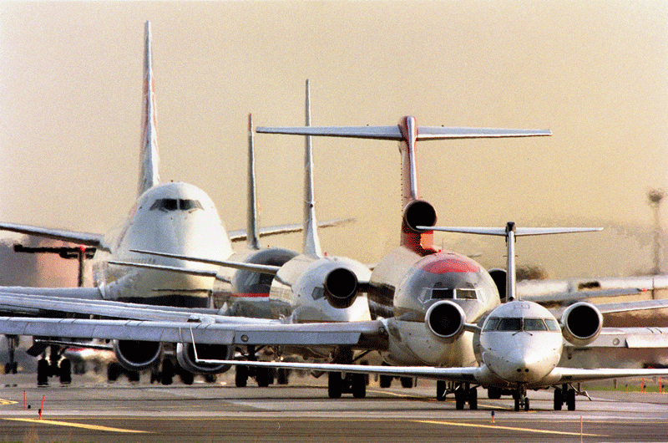
Notes:
Medical articles were deferring to the aviation industry to improve patient safety.
The Commercial airlines have a stellar safety record:
For example for every 1,000,000 departures they have 1.3 hull damages.

Slide 14
Moncton Flight College

Slide 15
What I will discuss
The Three Barriers to Good Judgment
An Algorithm to address them
The importance of Doubt in our practice
Being attentive to the task at hand - micro-vacationing

Slide 16
Three Barriers to good judgment
Hurry
Egoism
Apathy-fatigue- resignation

Slide 17
Hazardous Attitudes in Iowa Family Physician Study
When they make their most memorable error,
91 % of physicians said they felt hurried
30% felt fatigued
28% felt they had reached beyond their capabilities

Slide 18
Example of Egoism
“I was fearful of looking as incompetent as I was, so that I didn’t feel that I could call on the people that I really needed to help me. I wasn’t supposed to be calling. That was a sign that you were a ̀̀wuss’.”
Man becomes free through the realization of his nothingness. Sartre
Notes:
Here the brain defaults to the auto-pilot of maintaining rank among our peers.

Slide 19
The Three Barriers are…

Slide 20
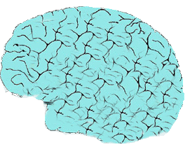
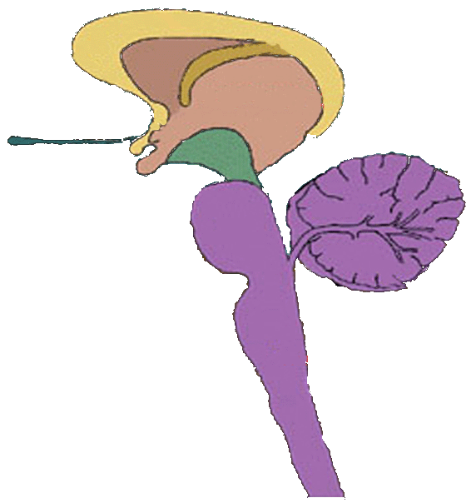

Slide 21
A vital sign to know when we are more error prone…

Slide 22
PVC in our irritability

Slide 23
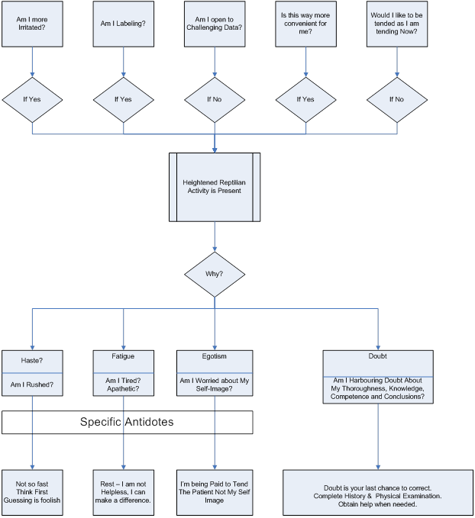

Slide 24
DOUBTING
Does it have value? Is it unmanly?
“IF SOMETHING DOESN’T LOOK OR FEEL RIGHT, IT PROBABLY ISN’T.” CRM Manual
Notes:
Other disciplines and Osler Chinese

Slide 25
Are the next letters Above or Below and Why?
A EF
$−−−−−−−−−−−−−→$
BCD

Slide 26
Strength of Doubt?
First Officer: “Uh, where are we… we going out to…”
Captain: “Let’s right to, uh, Tulua first of all. OK?”
A few seconds later, Captain identifies Tulua.
Captain: “Just doesn’t look right on mine. I don’t know why.”

Slide 27
Strength of Doubt?
“The engineer asking the captain; `is he not clear then?’
After repeating his question, the captain answers emphatically, `Oh, yes.’”

Slide 28
Strong Doubt near Cali

Slide 29
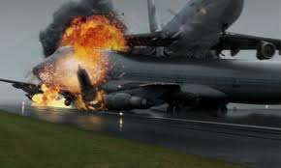
Weak Doubt at Tenerife

Slide 30
The Strength of Doubt…
Attachment to the New Brain
Doubting ∝ ---------------------------------------
Attachment to the Reptilian Brain

Slide 31
Signs of Doubting

Slide 32
For More signs of Doubt
See Handouts….
Finally….

Slide 33
Doubt may be the only stop sign on the road to Error
Notes:
Doubt is often the last stop sign on the on the road to error.

Slide 34
Attention to the Task at Hand
“I have so much stress when the pager goes I wonder what is it now? “

Slide 35
Take a Micro-vacation
Why?
How?

Slide 36
Why be Attentive
MRI study found major increase in gray matter density in the hippocampus----
self-awareness,
compassion,
and introspection.
(In Alzheimer’s disease the hippocampus is one of the first regions of the brain to suffer damage).

Slide 37
MRI study also found decreased gray-matter density in the amygdala, which is known to play an important role in anxiety and stress.
(No changes in the control group)

Slide 38
Take a Micro-vacation
How?
When going from one patient to the next….

Slide 39
Practice Attention to the Task at Hand
Practice vigilance to the task at hand,
At home
Driving… to work
At work
And even shoveling snow

Slide 40
ZEN ----- Be Present

Slide 41
Driving - there are rules…

Slide 42
Driving the are Speed Limits

Slide 43
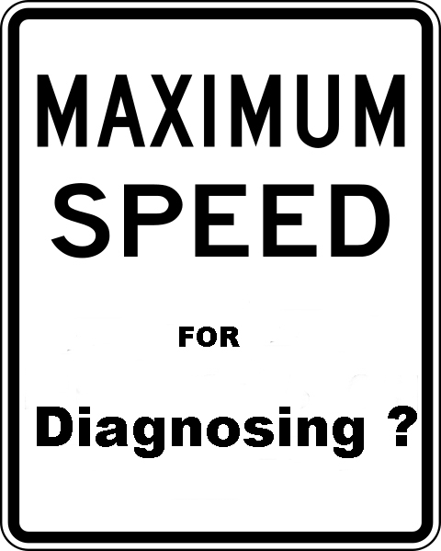

Slide 44
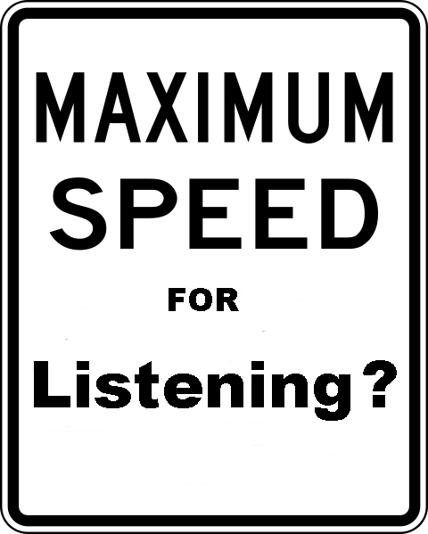

Slide 45
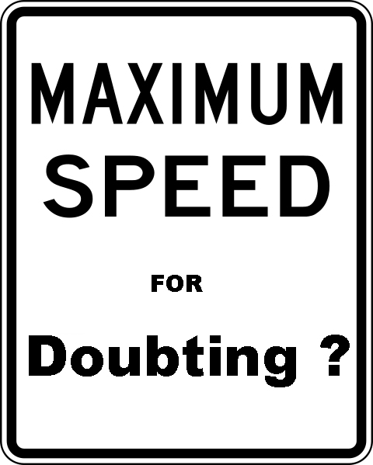

Slide 46
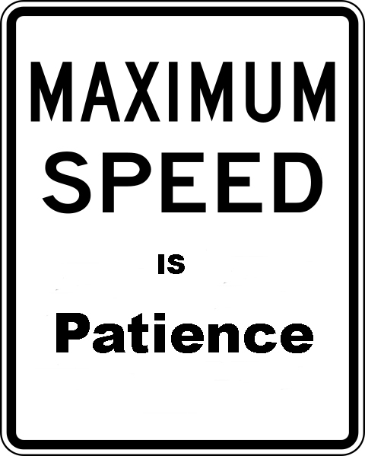

Slide 47
Do we have the Freedom ?

Slide 48
Dr. Frankl
Notes:
Spent three years in a laboratory….

Slide 49
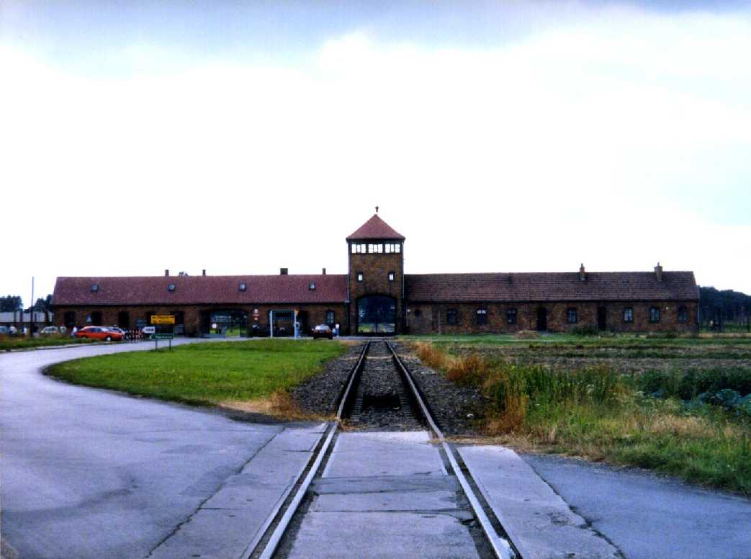
Notes:
Death Camps.

Slide 50
Dr. Viktor Frankl concluded that
Prisoners reacted differently to the same system
The one thing the captors could not take away was one’s freedom to respond
We define ourselves by our responses regardless of the circumstances
Notes:
The crew monitor each others attitudes. But for the doctor or the nurse

Slide 51
We have the Freedom…

Slide 53
ZEN ----- Be Present

Slide 56
Returning to Mr. Weston
90/50 mm Hg
Pulse 110/min
Autopsy showed that he had a volvulus
and no fluid in his bladder.
I share these insights because….

Slide 57
Thanks
?
Evaluations and Suggestions

