Slide 1


Slide 2
Wellness Inspiration Capsule
Presented by
Nancy Ferguson Robichaud
Public Health Nurse
September 2015
This capsule is a courtesy of...

Slide 3
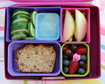
Wellness Inspiration Capsule
Environmentally friendly lunch box
This capsule is a courtesy of...

Slide 4

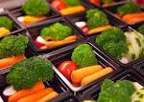
Environmentally friendly lunch box
Why?
To take care of the planet
To take care of our health
To save money
This capsule is a courtesy of...

Slide 5
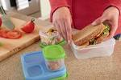
Environmentally friendly lunch box
How?
For a zero waste lunch, put food in reusable containers.
Assess your food needs to prevent waste.
Compost fruit and vegetable peelings/scraps.
This capsule is a courtesy of...

Slide 6
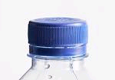
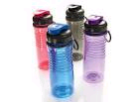
Environmentally friendly lunch box
How?
Use a reusable drinking bottle for water and other beverages instead of canned or bottled beverages.
Did you know that it takes 1.3 litres of water to produce one litre of bottled water?
We reduce waste when we use a
reusable water bottle.
This capsule is a courtesy of...

Slide 7

Environmentally friendly lunch box
Avoid using resealable bags.
Did you know that most plastic materials are derived from petroleum, a non-renewable resource?
Plastic bags take anywhere from 100 to 400 years to decompose!
This capsule is a courtesy of...

Slide 8
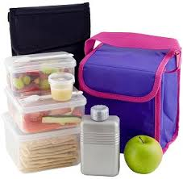



Environmentally friendly lunch box
Advice
Reduce or avoid the use of plastic products bearing the following recycling numbers:
Do not heat food in plastic containers. Use glass containers instead.
This capsule is a courtesy of...

Slide 9


Environmentally friendly lunch box
To your health and the planet’s!
Bon appétit!
This capsule is a courtesy of...

Slide 10

Join us!
Réseau mieux-être
Péninsule acadienne

