Slide 1

ANNUAL MEMBERS’ MEETING
June 5, 2020

Slide 2
We respectfully acknowledge that the land on which this meeting is hosted is the traditional, ancestral, and unceded territory of the Wəlastəkewiyik (Maliseet) and Mi’kmaq peoples. This territory is covered by the “Treaties of Peace and Friendship” which were first signed by the Wəlastəkewiyik (Maliseet), Mi’kmaq and Passamaquoddy Peoples with the British Crown in 1726. The treaties did not deal with the surrender of lands and resources, but rather recognized Wəlastəkewiyik (Maliseet) and Mi’kmaq title and established rules for an ongoing relationship between the nations. As guests on this land, we recognize that the many historic injustices experienced by the Indigenous peoples of what we now call Canada continue to impact health and well-being. The NBCFP respects that Indigenous people in Canada have rich cultural and traditional practices that have been known to positively improve health outcomes. We commit ourselves to gaining knowledge, forging a new, culturally safe relationship and contributing to reconciliation.
Land Acknowledgement

Slide 3
Simultaneous interpretation:
Members who require simultaneous translation, please go to language preference icon located at the bottom of your screen, (it looks like a globe or world icon and select “French”.
Raise Hand Feature:
If a participant would like to address the Chair or ask a question, please use the “Raise Hand” feature and wait until the Chair addresses them. The “Raise Hand” icon is located at the bottom of your screen. Please "Lower Hand" once your question has been answered.
Zoom – Raise Hand Feature

Slide 4
Voting for motions:
A poll will appear on the screen after the motion slide, it will have multiple options including “In Favour”, “Against”, “Abstain”, and “Discussion Required”.
Participants will select one option and submit their response.
If a “Discussion is requested, the participant must select “Raise Hand” and the Chair will call on the member to speak.
Zoom – Motions & Speaking

Slide 5
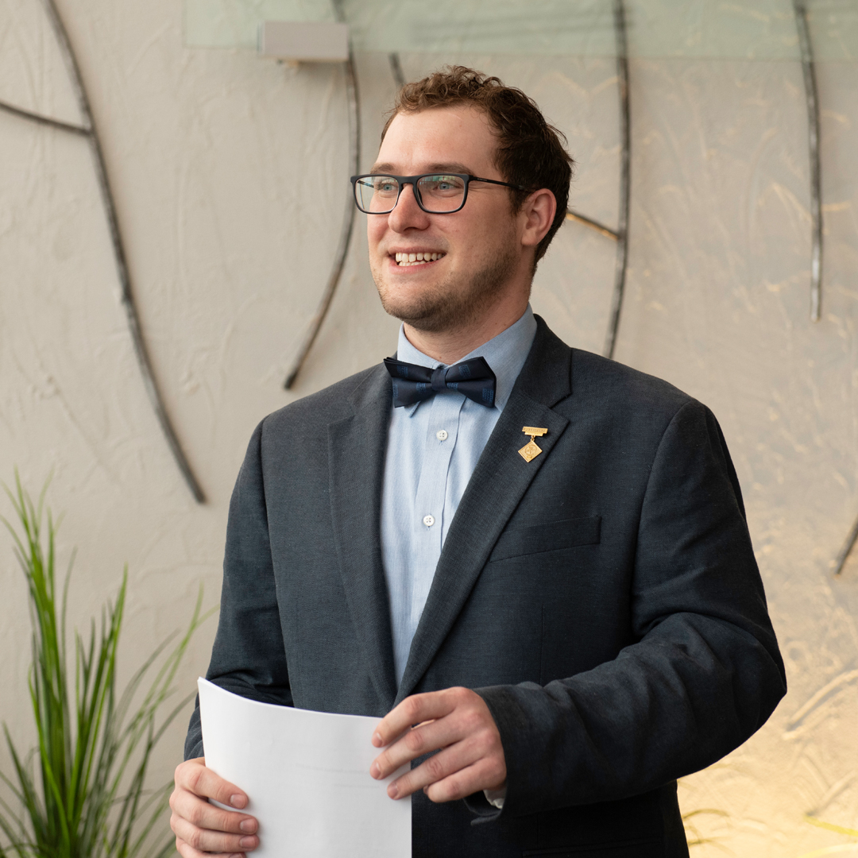
NBCFP President
Dr. Darren Martin
Dr. Darren Martin will call the meeting to order
Quorum
Declaration of any conflicts of interest on any agenda items

Slide 6
Revised Agenda, NBCFP AMM, June 5, 2020:
1. Call to order, Dr. Darren Martin
2. Quorum (20 members, Bylaw #11.9)
3. Declaration of any conflicts of interest
4. Approval of Agenda
5. Approval AMM Minutes, May 11, 2019
6. Report of the Honorary Treasurer/Presentation of the financial statements for the year ending December 31, 2019
7. Approval of 2019 financial statements
8. Approval of Grant Thornton as auditor for 2020
9. Report from the President, NBCFP
10. Report from the College of Family Physicians of Canada
11. Presentation of slate of officers for 2020-2021
12. Members’ Forum
13. 2020 Awards
14. 2020-2022 President installation
15. Adjourn

Slide 7
Motion: Approval of Agenda

Slide 8
Motion: Approval of 2019 Minutes,
Annual Members’ Meeting

Slide 9
Grant Thornton
Financial Statements
Louise Blanchard, CPA & Senior Manager with Grant Thornton, will present the financial statements ending December 31, 2019
Full financials can be found at https://www.nbcfp.ca/about/annual-meeting-of-members/

Slide 10
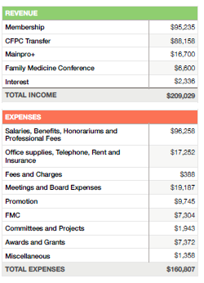
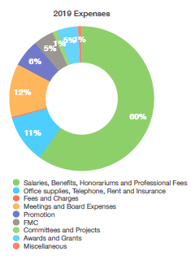
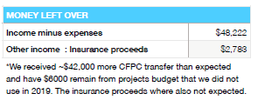

Slide 11
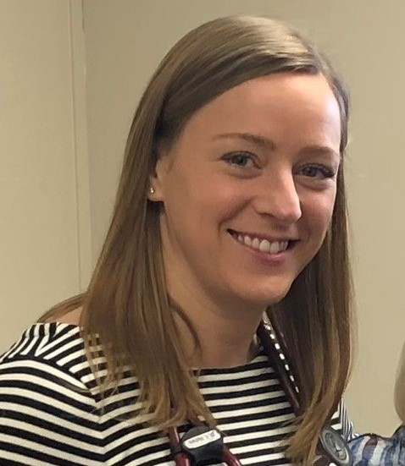
Honorary Secretary/Treasurer
Dr. Katelyn Stymiest
Motion:
That the financial statements for the fiscal year ending December 31, 2019 be approved as presented.

Slide 12
Honorary Secretary/Treasurer
Dr. Katelyn Stymiest
Motion:
That Grant Thornton be appointed as auditors for the NBCFP for the 2020/2021 fiscal year.

Slide 13
NBCFP President’s Report
Dr. Darren Martin

Slide 14

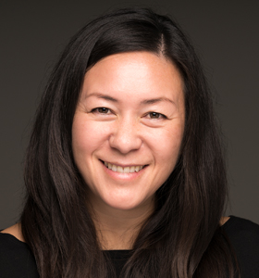
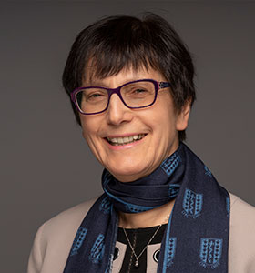
CFPC Report
Dr. Shirley Schipper, President
&
Dr. Francine Lemire, Executive Director & CEO

Slide 15
Presentation of 2020-2021
NBCFP Board of Directors
President : Dr. Ghislain Lavoie
President Elect : Voted in 2021
Past President : Dr. Darren Martin
Secretary-Treasurer : Dr. Karine Boulay
Member at large : Dr. Natalie Cauchon
Member at large : Dr. Amélie Thériault
Member at large : 2 vacancies

Slide 16
Presentation of 2020-2021
NBCFP Board of Directors (cont’d)
CPD : Vacant
FFYFP : Dr. Roxanne Pelletier
Health and Wellness : Vacant
Member Value : Dr. Darren Martin
Quality Improvement : Vacant
Université de Sherbrooke : Dr. Lise Babin (faculty); Vacancies (resident & student positions)
Dalhousie University : Dr. Sasha Sealy (faculty); Vacancies (resident & student positions)
Memorial : Faculty (TBD); Vacant (Student)

Slide 17
Motion: That the 2020-2021 NBCFP Board of Directors be approved as presented.

Slide 18
Members’ Forum

Slide 19
2020 Awards
c
Congratulations to all Award Recipients

Slide 20
Family Physician of the Year
This award is granted annually to recognize an outstanding New Brunswick family physician who embodies the four (4) principles of family medicine:
      Be a skilled Clinician
      Be community based
      Act as a resource to a practice population
      Recognize the central importance of the doctor-patient relationship
Dr. Jennifer Russell
Fredericton, New Brunswick

Slide 21
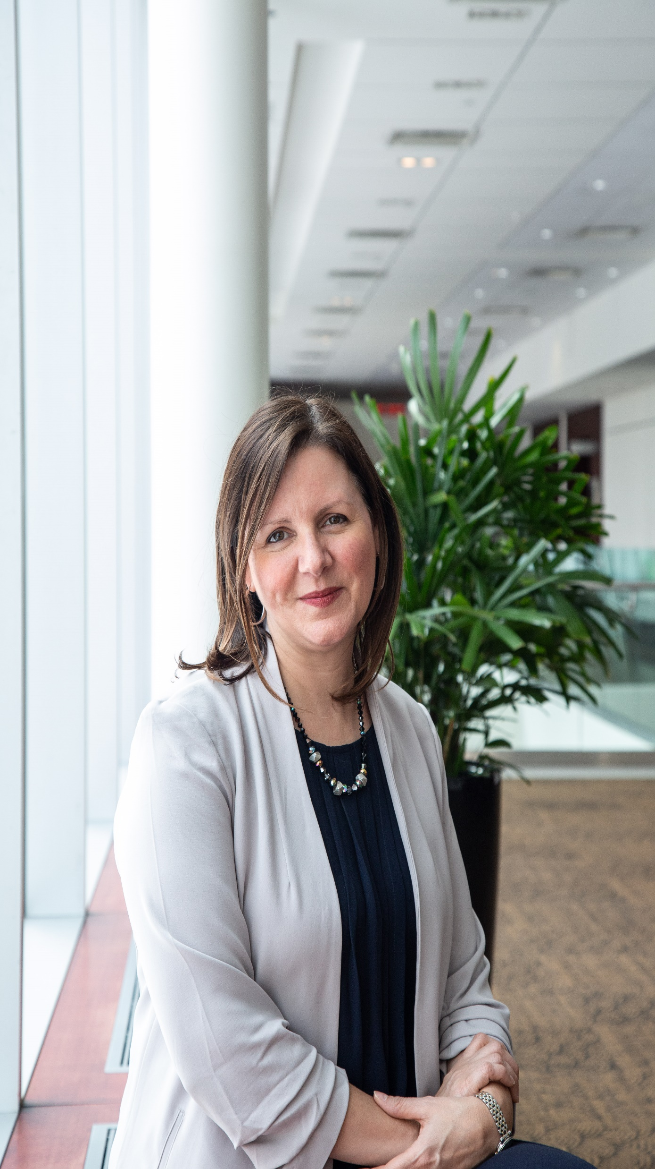
Dr. Jennifer Russell
Family Physician of the Year
She studied Science at University of New Brunswick, Medicine at Memorial University of NL and was a resident in family medicine at Dalhousie University.
Currently the Chief Medical Officer for the province of NB.
Her handling of the pandemic has brought her widespread visibility.
Recognized for her outstanding leadership abilities, interdisciplinary teamwork and for being fluently bi-lingual as she communicates information to the public during the pandemic.
Her high standard of professionalism is evident in all that she does to educate and empower informed decisions about COVID-19.
Through it all, she is continuously aiming her dedication to the well-being of the people in her province in these challenging times.

Slide 22
Award of Excellence
This award recognizes members who have made an outstanding contribution in the past 12 to 24 months to one or more of the following areas: patient care, community service, hospital or health care institutions, College activities (national or Chapter), teaching, research or other elements of the academic discipline of family medicine.
All New Brunswick Family Physicians

Slide 23
First Five Years in Family Practice Award
This award recognizes a family physician in his or her first five years of family practice who has not only established a practice, but has demonstrated balance through commitment to family, patients, colleagues and community.
Dr. Janice Townson
Saint John, New Brunswick

Slide 24
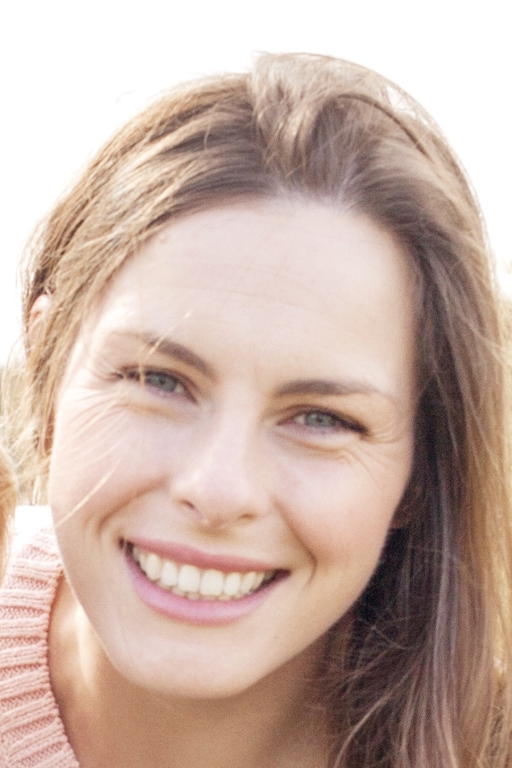
Dr. Janice Townson
First Five Years of Family Practice Award
Completed family medicine residency at Dalhousie, Saint John site (2016)
Has a community-based family practice at the Community Health Center in Saint John, which serves a high needs population, provides a full spectrum of care from prenatal/obstetrics to newborn care to elderly and dying patients, and inpatient care
Actively participates in various teaching and leadership roles within the medical school.

Slide 25

Family Medicine Teacher of the Year
Dr. Sarah Caines
Rothesay, New Brunswick

Slide 26
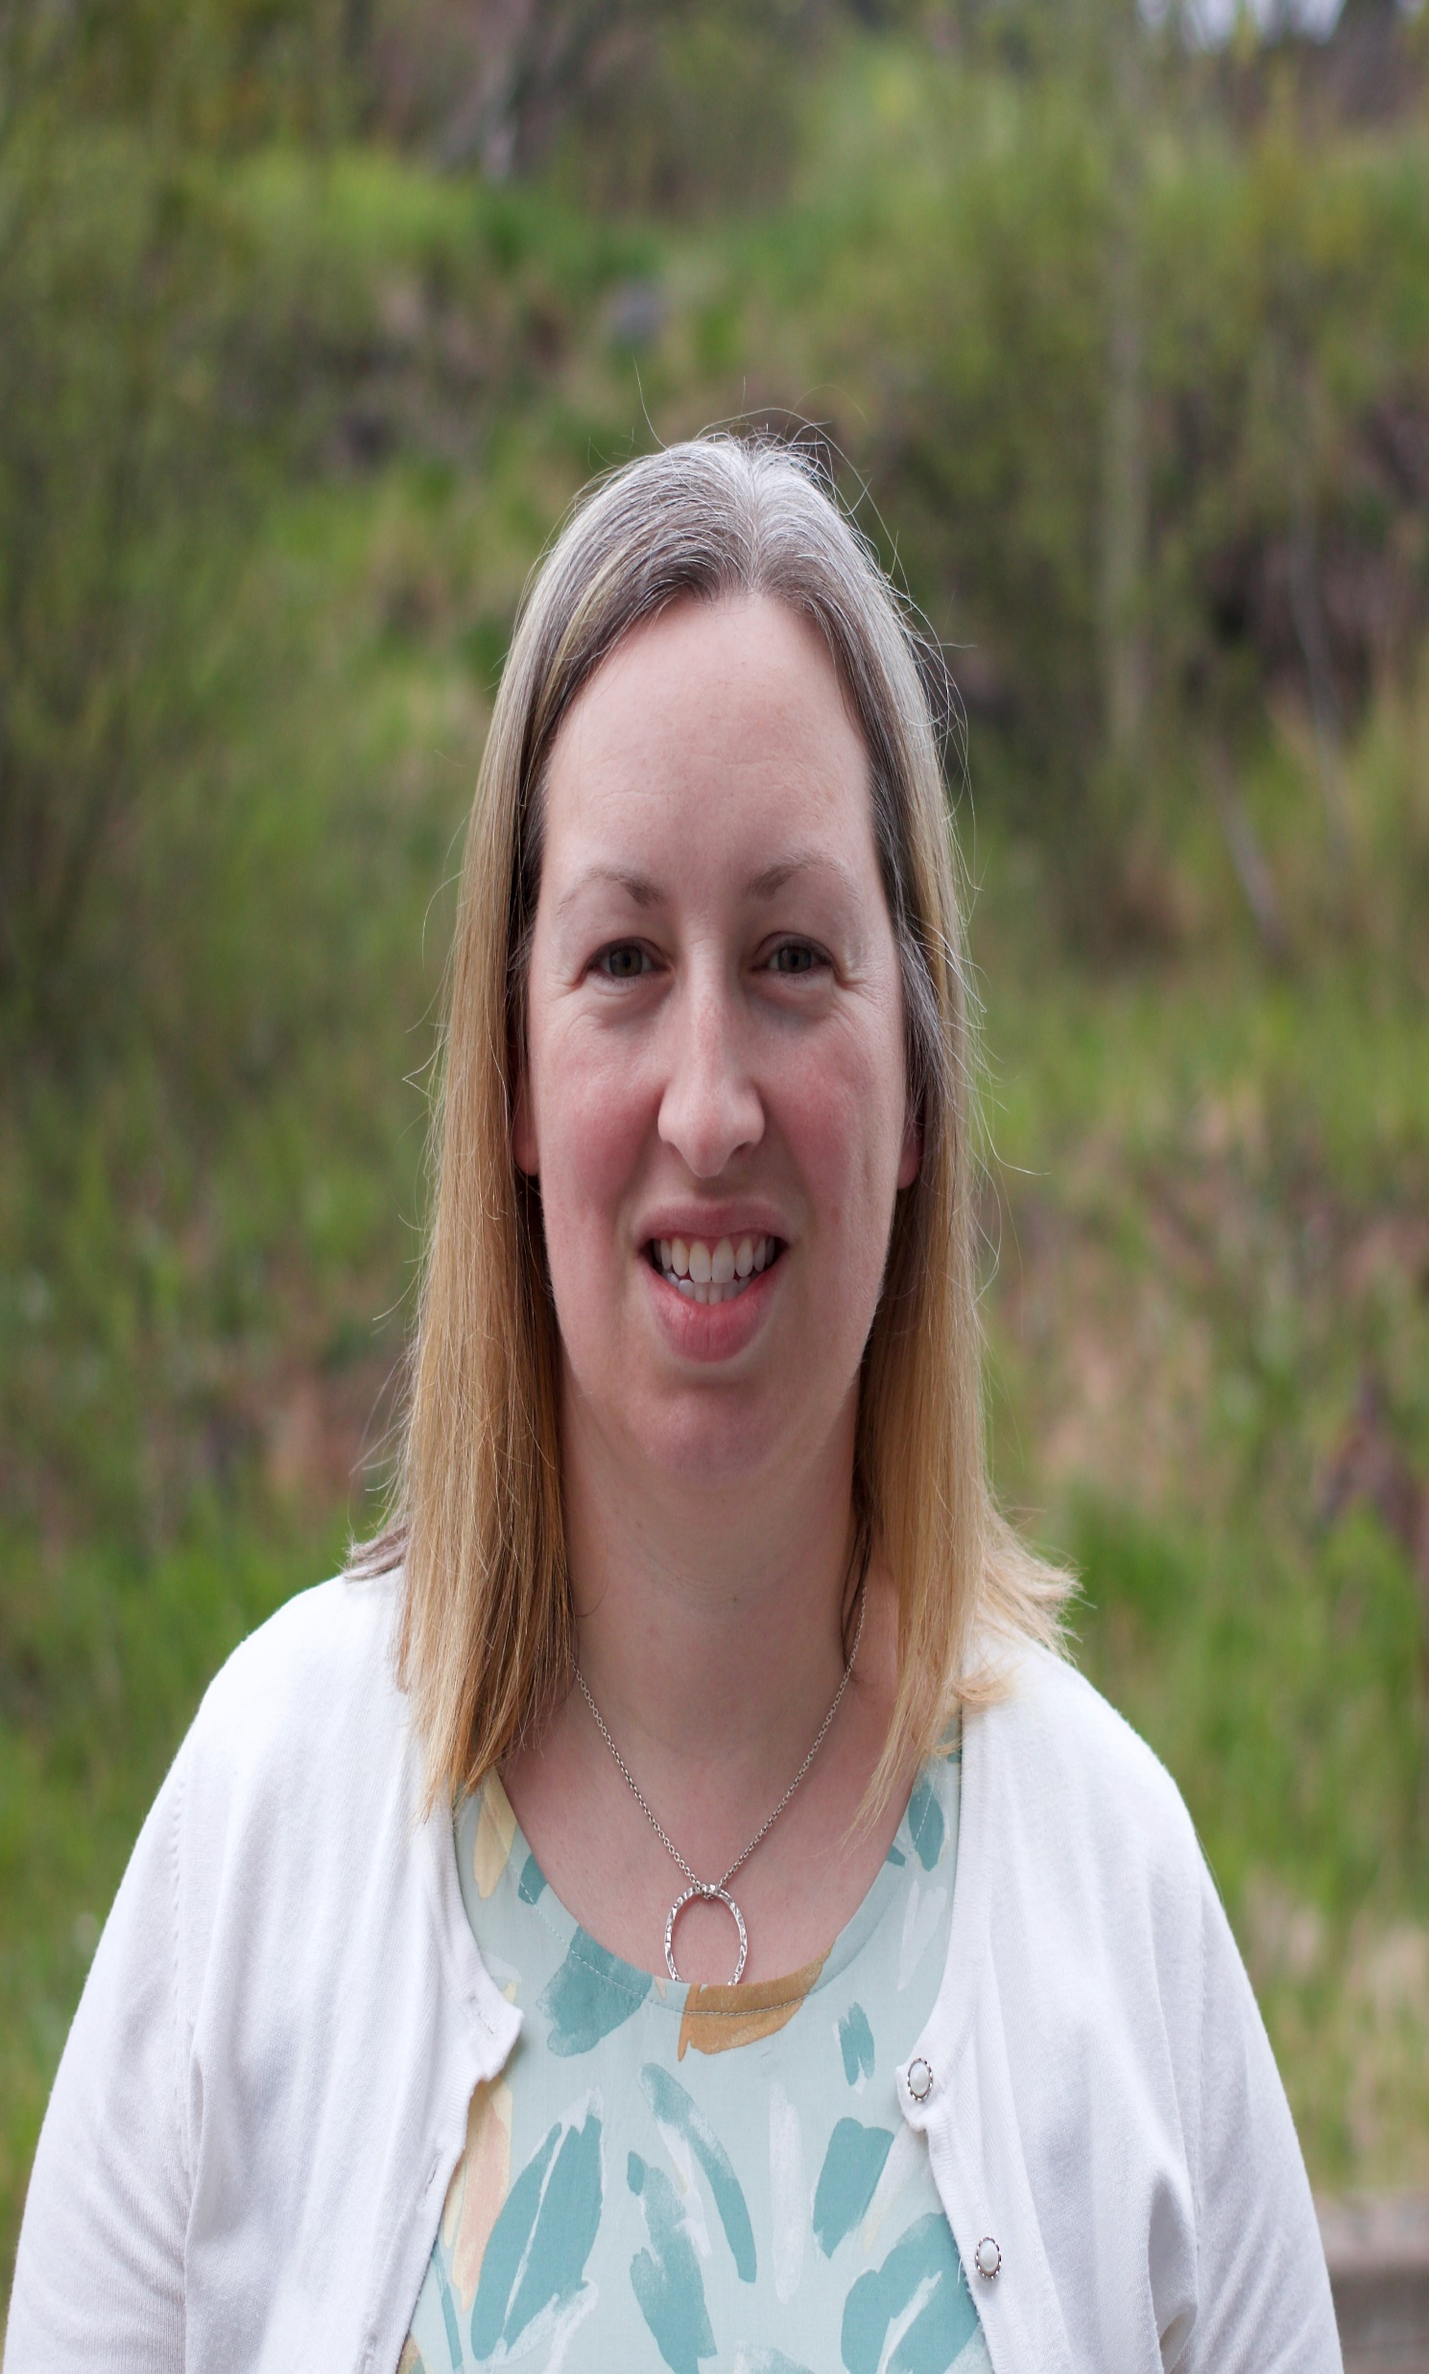
Dr. Sarah Caines
Family Medicine Teacher of the Year
Graduate of Memorial University of Newfoundland Medical School (2006); completed postgraduate residency training through Dalhousie Family Medicine in Saint John (2008)
Has spent many years teaching Clinical Skills at the Undergraduate Level at DMNB and has had learners of all levels in her clinical practice.
She is a Core Family Medicine Preceptor to one of the Dalhousie Family Medicine Residents at the Saint John Site; has served as a Resident Project supervisor; and is the Curriculum Coordinator for the Saint John Family Medicine Teaching Unit.

Slide 27
Family Medicine Resident Leadership Award
Lyndsay Lovely
New Maryland, New Brunswick

Slide 28

Lyndsay Lovely
Family Medicine Resident Leadership Award
2nd year family medicine resident at the Fredericton Site of Dalhousie Family Medicine and graduated from Dalhousie Medicine New Brunswick in 2018
Valuable link between the learners in Fredericton and the medical society and has helped the Society organize medical learner events over her two years in the program.
Lyndsay is moving on to an enhanced skills fellowship in Ottawa in Family Practice Anesthesia this July and has been working on developing a practice opportunity upon finishing her training.
Even while juggling a young family and studying for exams, Lindsay has been meeting with local representatives of the Dept of Health, Horizon Health Network, Community Health Centers and Division Heads at the Dr. Everett Chalmers Regional Hospital to develop a niche for family practice anesthesia and chronic pain management here in Fredericton.

Slide 29
Dr. Sharon Northrop Award
Dr. Carole Clavette
Edmundston, New Brunswick

Slide 30
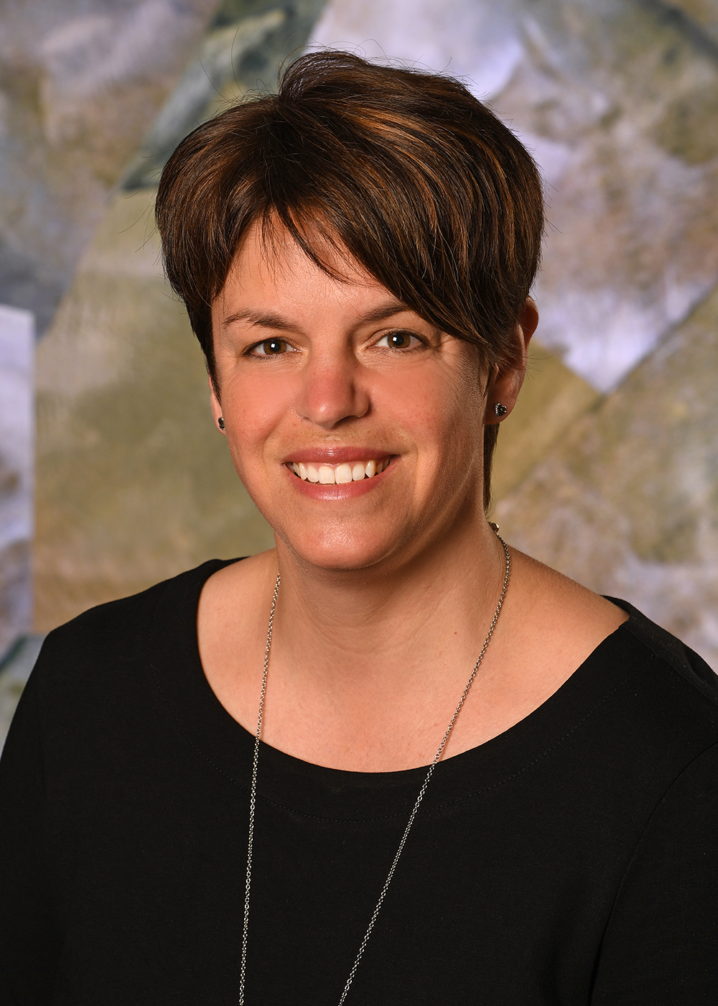
Dr. Carole Clavette
Dr. Sharon Northrop Award
Graduate of Laval University Medical School and completed postgraduate residency training in Moncton; began her practice in Edmundston in 2001
Currently practicing OBS, Family medicine office, Operating room assistance and supervision of residents
Devoted to the maternal wellbeing of patients in the Edmundston area for many years and essential for obstetrical care in North West New Brunswick
- Occupied many positions at the Edmundston Regional Hospital Foundation, such as: Spokesperson from 2014 to 2016, member of the Board of directors from 2016 to 2019, and member of the organizing committee of the annual golf tournament since 2014.

Slide 31
Patient’s Medical Home
Outstanding Family Practice Award
This award will be granted annually to the Family Physician or Physician Practice Group that best embodies the CFPC’s
principles of The Patient’s Medical Home.
The Moncton Medical Clinic
Moncton, New Brunswick

Slide 32
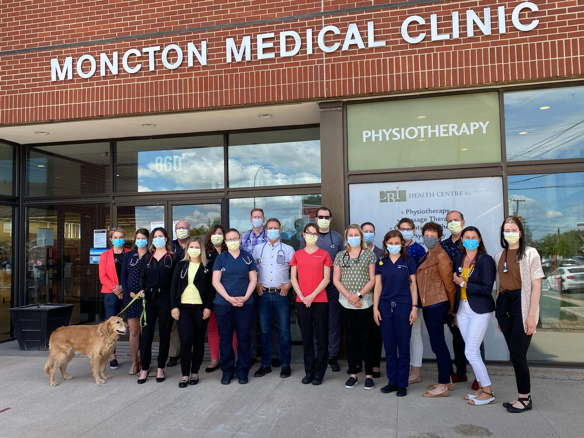
Patient’s Medical Home Award Outstanding Family Practice Award
The Moncton Medical Clinic (MMC)
The values that prompted the original six family physicians in 1968 to start the MMC have persisted
in the current culture of the group.
MMC is an academically inclined clinic offering extended office hours, 24-hour provision of care, both in the community and in hospital; effective EMRs with full medical record availability for on call physicians;
a collaborative model of care; a focus on continued professional development and values that ensure all clinic patients are well cared for even when their family physician is not available.

Slide 33
Teddy Bear Grant
A grant to help facilitate a clinic to help familiarize children with medical tests and procedures regularly performed during a visit to the family doctor. Children bring their favourite teddy bear and practice these tests/procedures on their little patient.
Hampton Family Medicine
Hampton, New Brunswick

Slide 34
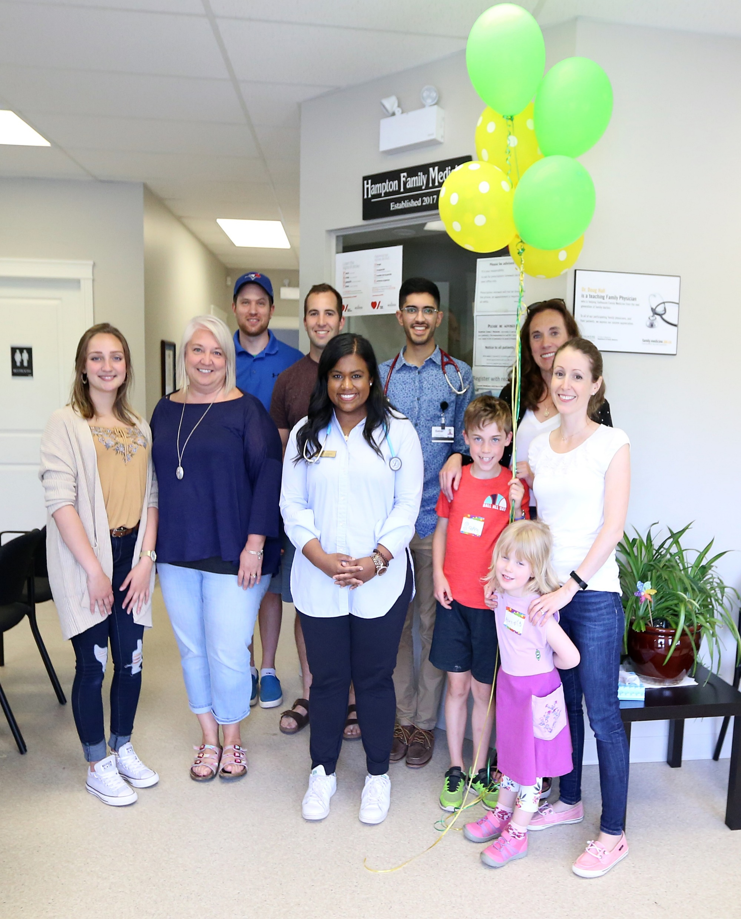
Teddy Bear Grant
Hampton Family Medicine

Slide 35
2020 Awards
c
Congratulations to all Award Recipients

Slide 36
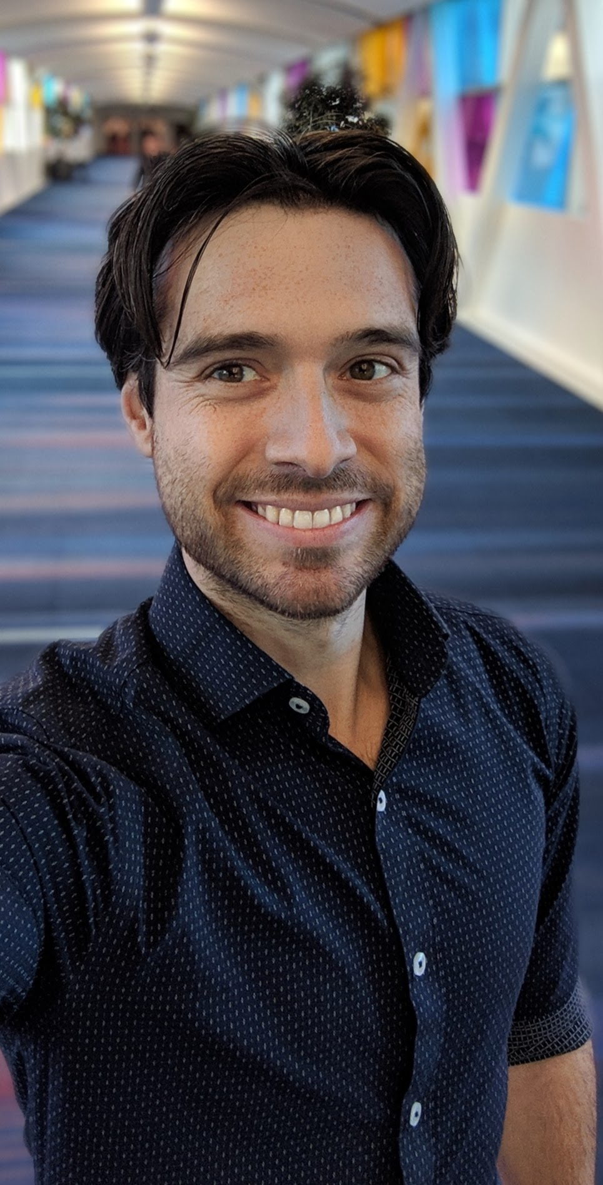
Installation of new
NBCFP President
Dr. Ghislain Lavoie

Slide 37
Dr. Ghislain Lavoie
Born in Moncton, raised in Fredericton, and worked across the province during his training
Graduated from Université de Montréal in 2012 and Université de Sherbrooke in 2014
Works as a family physician at the UMF du Grand Moncton
Head of the local Division of Family Medicine at the CHUGLD
Head of the Department of Family Medicine in Zone 1B
Medical Director of Faubourg du Mascaret
Clinical Professor at UdeS

Slide 38
Adjournment

